Slide 1

S
tress-free
imple
ecure
Terminal 3, Dubai International (DXB)

Slide 2



About
DXB Greet & Go is a smart new pickup solution at Terminal 3 Arrivals, designed especially for guests who've opted for hotel or tour operator services.
Replacing handheld signs and pagers, this initiative streamlines the guest pickup process by directing arrivals to a dedicated DXB Greet & Go area, where they simply scan a QR code and are seamlessly connected with their pickup representative.
Aligned with our mission to delight guests the Dubai way, this initiative helps create an exceptional first impression from the moment guests land—offering a stress-free, simple and secure experience.
It also improves operational flow, reduces crowding and visual clutter in the arrivals hall, and enhances the overall aesthetic of the guest environment.

Slide 3




Who can use it?
Hotels
Limousine companies
Tour operators
This service is designed perfectly for:

Slide 4
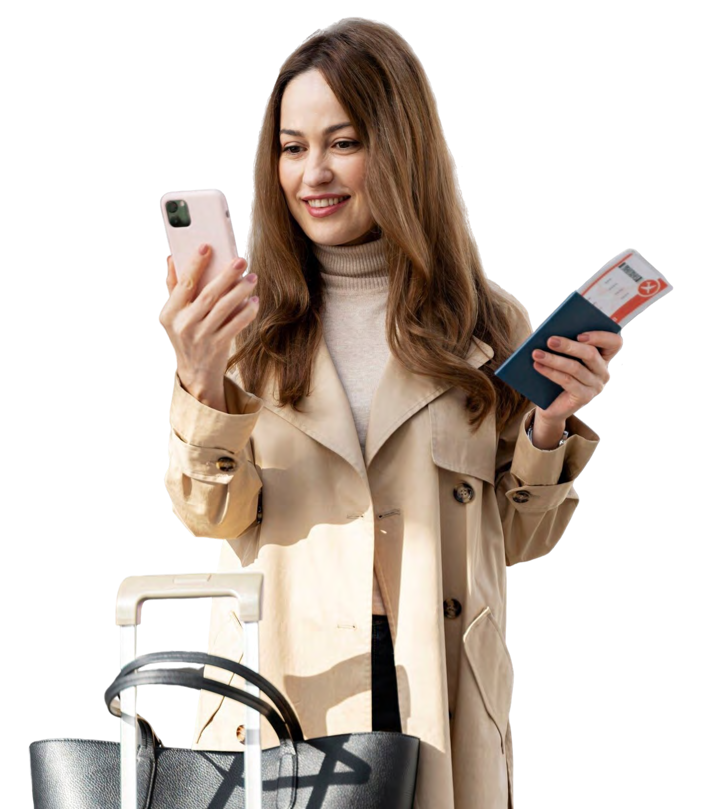
Service fee
Each business must maintain a minimum eWallet balance of AED 1000. Charges for all services at DXB Greet & Go are deducted directly from your eWallet Balance at the time of booking
Service category 1: For Greet & Go service:
Individual booking up to 7 guests – service fee is AED 30 (system will not allow to book 8 guests, in this case, small group booking must be created)
Small group up to 8-25 guests – service fee is AED 40 (system will not allow to book 26 guests, in this case, large group booking must be created)
Large group up to 26-50 guests – service fee AED 50 (system will not allow to book 51 guests, in this case, individual, small group booking must be created, subject to number of guests in addition to 50)
Groups can use the same QR code, which will be applicable for multiple guests.
Service category 2: For Greet & Go + Limousine service:
The service fee is as above (excluding VAT), for wait time up to 15 minutes, plus limousine service provided by Valtrans with charges applicable as per the pricing list/location (page 26 onwards).
If the driver does not arrive within the 15-minute window, Valtrans will dispatch a vehicle from their Limo Service to avoid any delay for the guest.

Slide 5


Key benefits
Enhanced guest experience:
Premium & organised meeting point – The centralised DXB Greet & Go area provides a structured and seamless experience for arriving passengers, eliminating the confusion and overcrowding at the arrivals hall.
Compliance & security:
Eliminates unauthorised touting – Only registered operators can use DXB Greet & Go services, reducing the risk of unauthorised agents approaching passengers.
Operational efficiency for operators:
Seamless registration & digital payment process – The online registration portal and eWallet system simplify fund management and transaction processing.

Slide 6
Key benefits
Business & revenue benefits:
Increased credibility & brand image – hotels, tourism agencies, and limo operators offering this service enhance their reputation with a premium airport experience
Higher customer retention – a seamless arrival experience increases guest satisfaction, leading to repeat business for the operators
Advantages of the DXB Greet & Go with limousine option:
End-to-end convenience – guests receive an
all-in-one service from arrival to their final destination
Premium limousine dispatch – Valtrans ensures timely and professional limousine service, enhancing guest experience

Slide 7
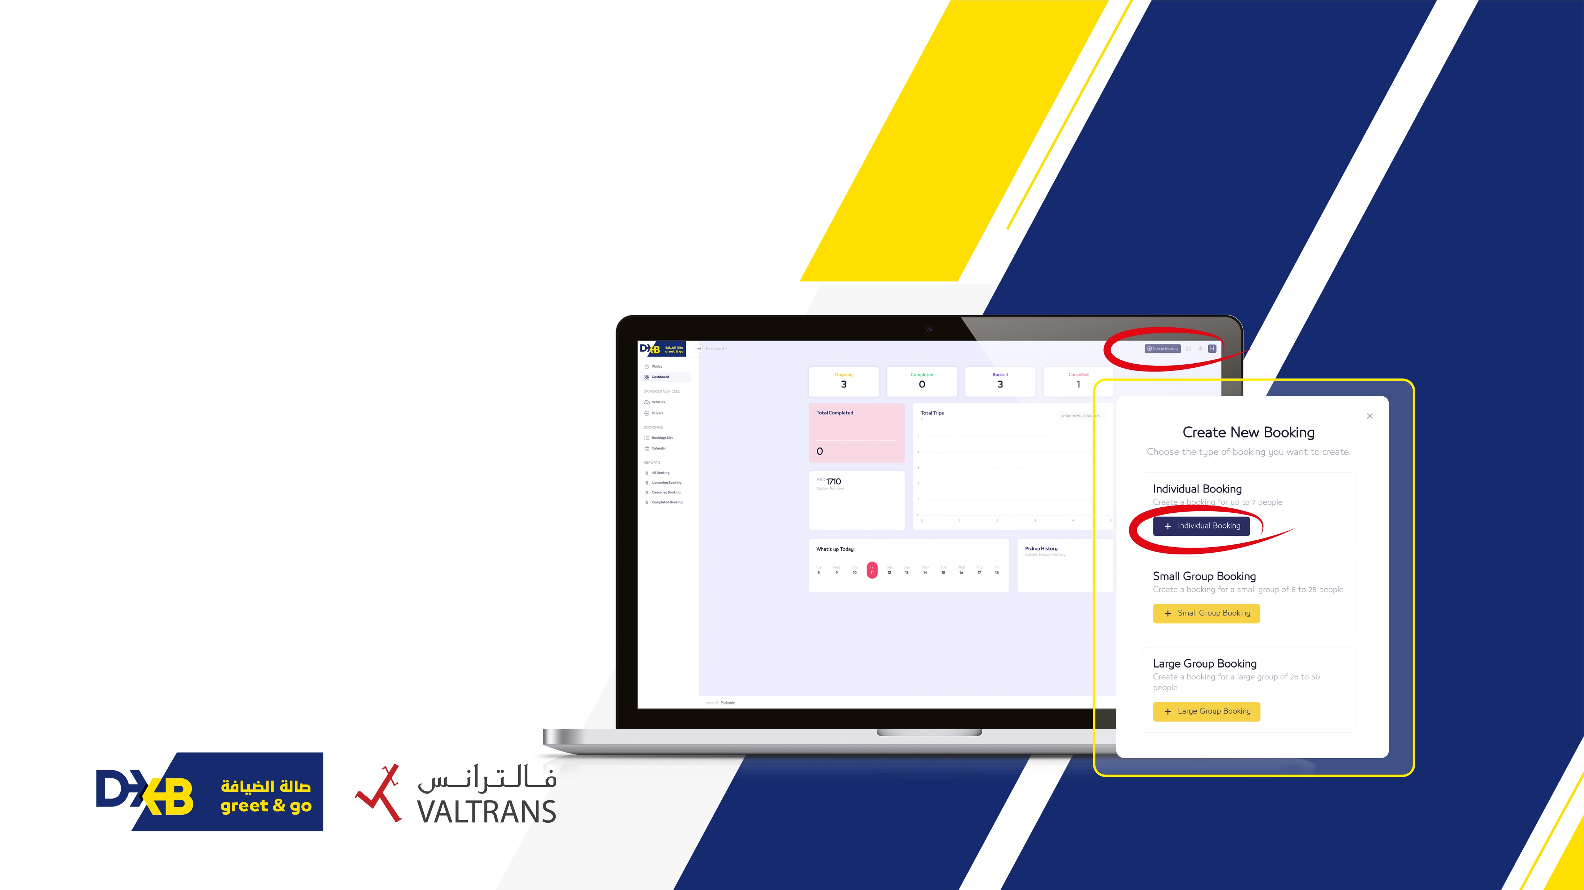
How it works
Create booking:
Each business must create a booking using the admin portal:
Own business cars & drivers fleet:
Once you add and register your vehicles & driver details via admin portal, bookings can be assigned whenever requested by a guest
Valtrans limousine service:
This service will be enabled in case the driver doesn't show up or delayed beyond 15 minutes

Slide 8
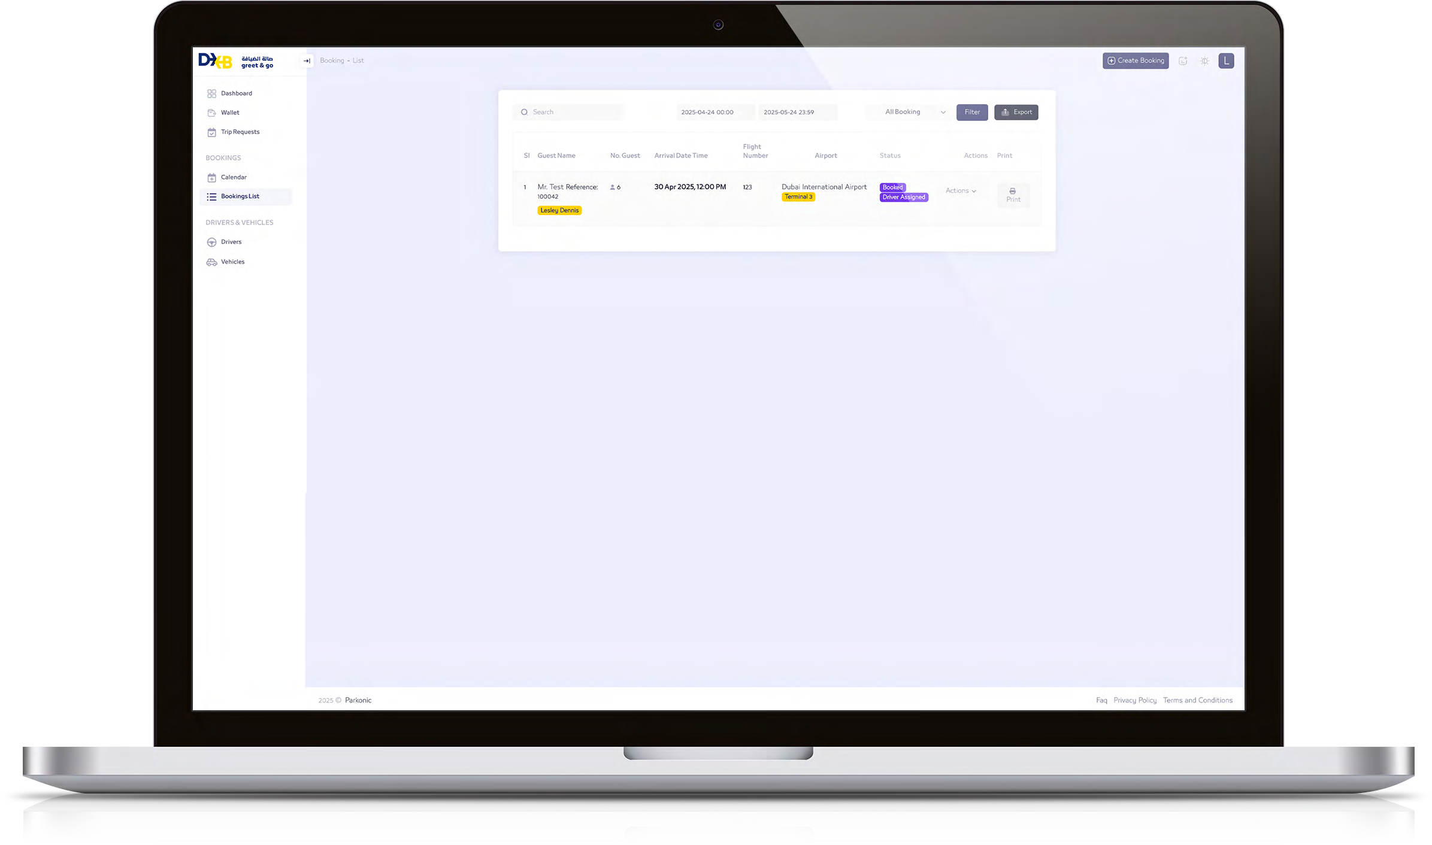

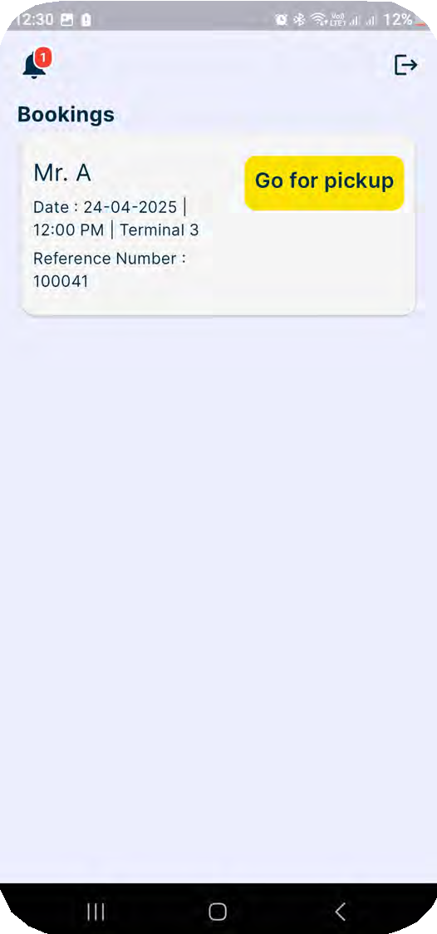
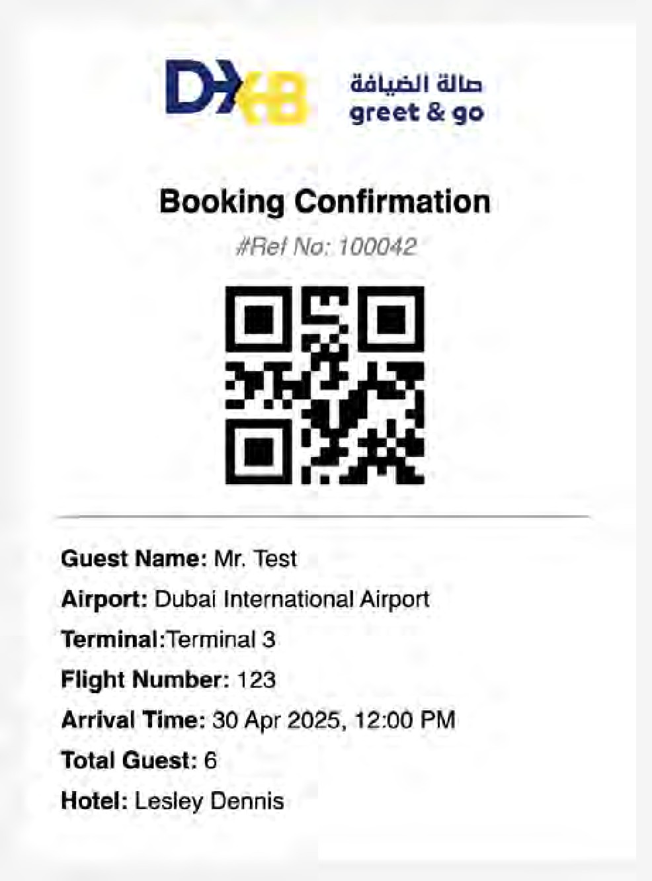


How it works
QR code sharing:
Each business will send a booking confirmation (QR Code) to the registered guest via email.
      The assigned driver receives notification through the driver app on their mobile device.
      If QR codes are not generated or cannot be shared, booking details can be retrieved using the guest’s name and reference number.

Slide 9
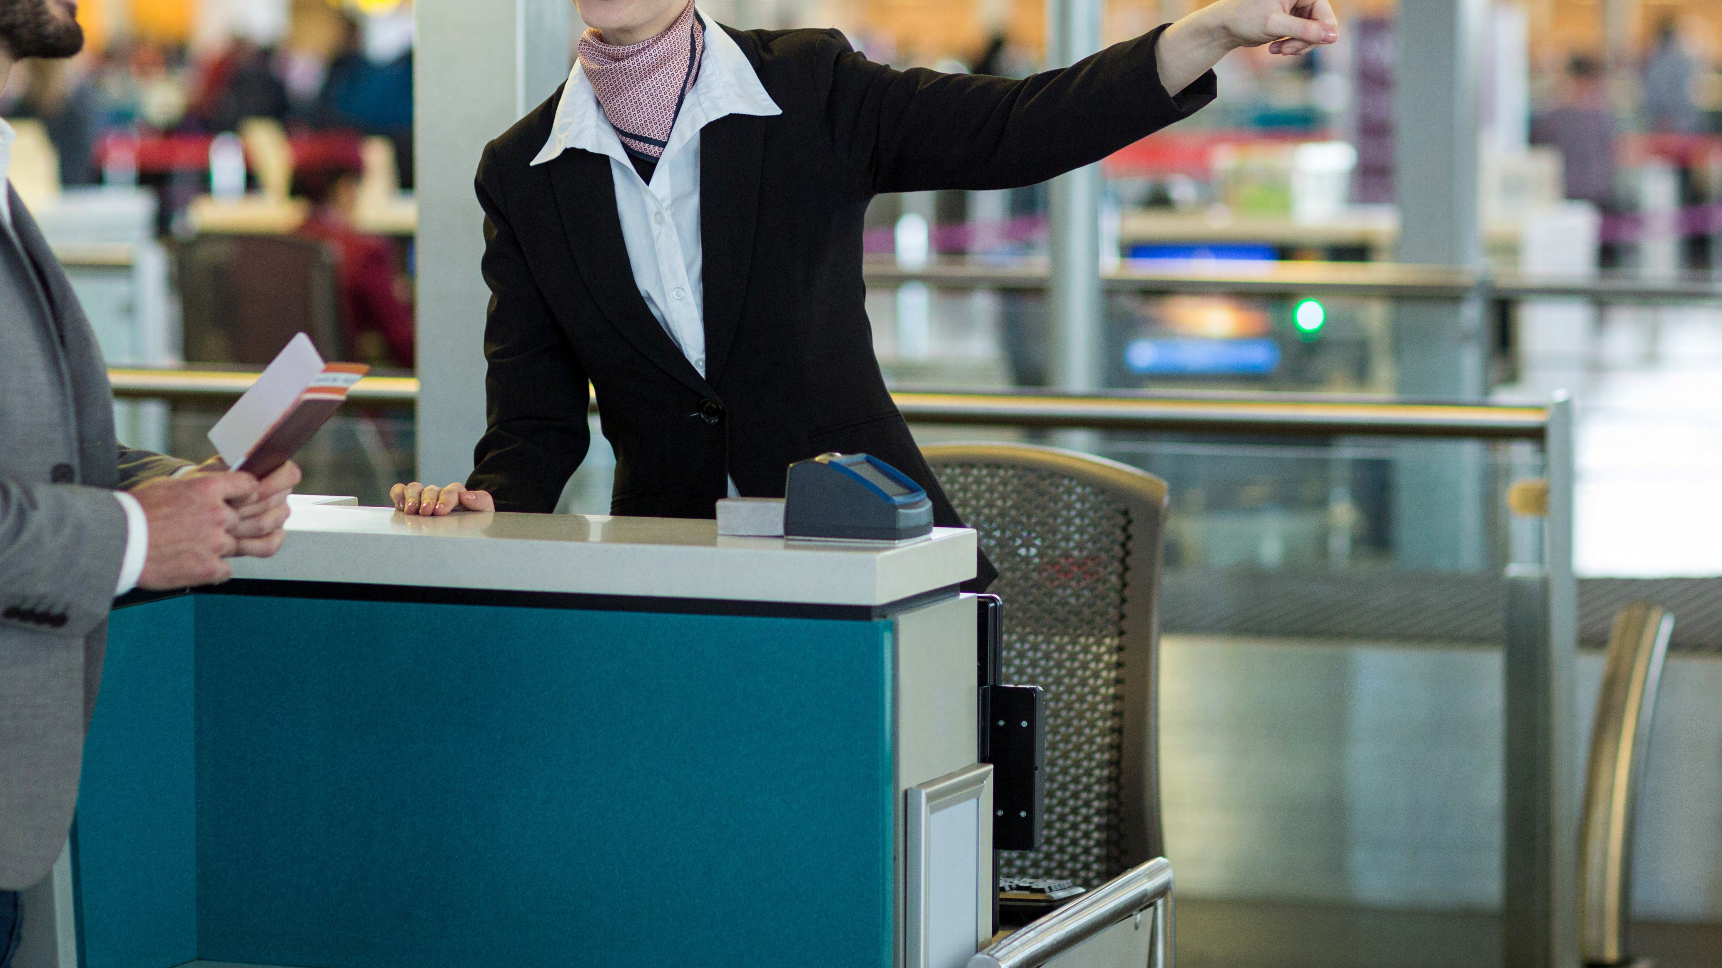



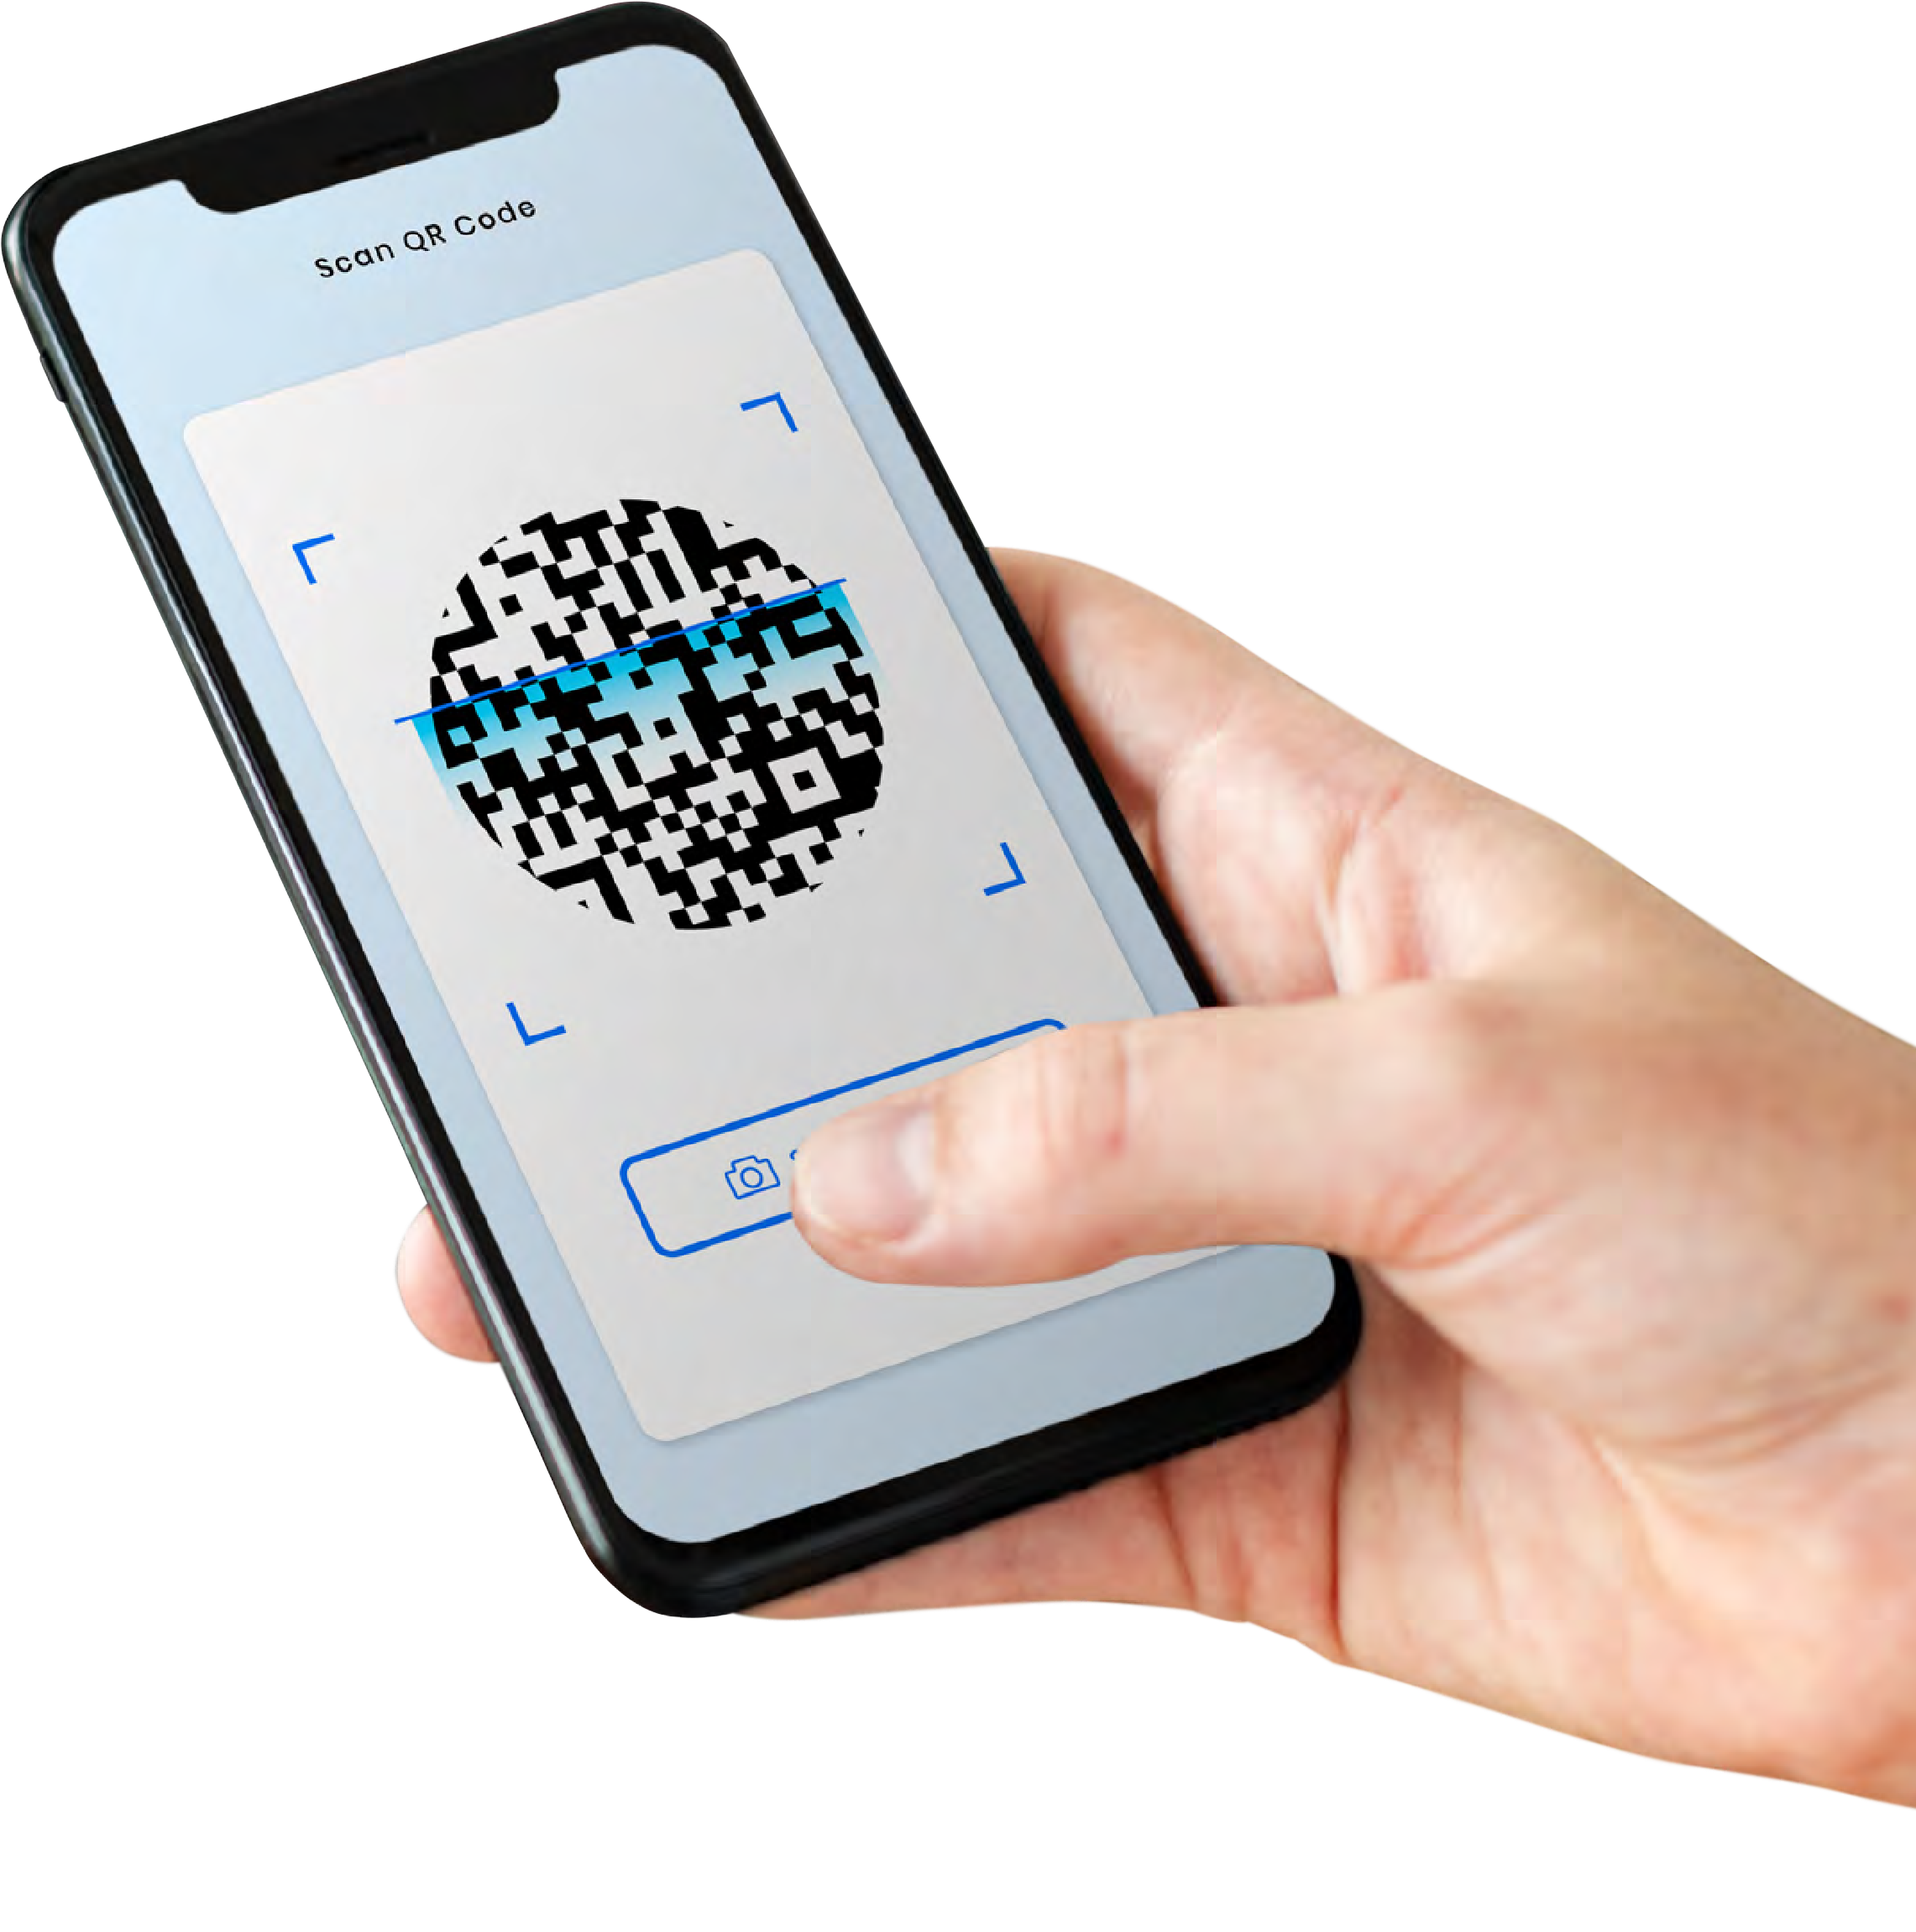
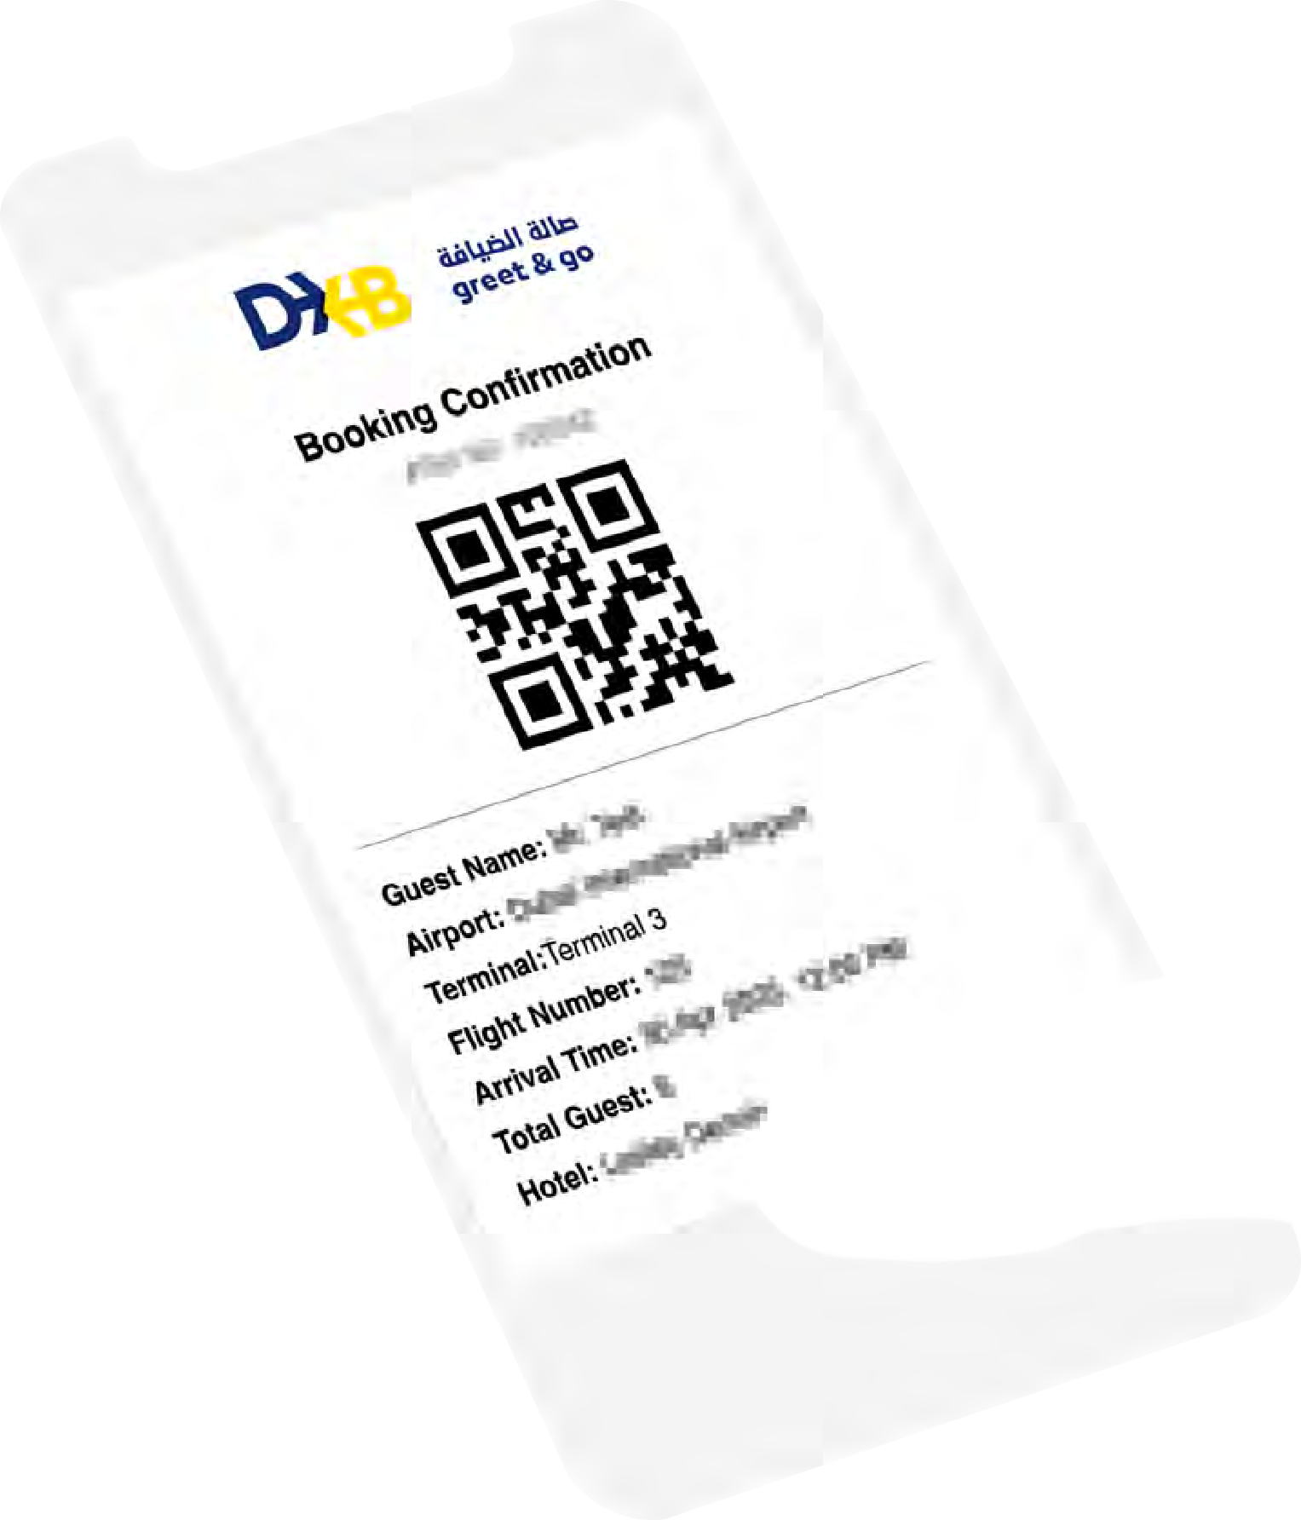





How it works
Guest arrival:
Upon arrival, guest is met by a DXB Greet & Go Receptionist or a Customer Service Representative followed by a Host.
Scan your QR code Or
Enter Reference Number
Success
Driver Name: John
Driver Status: Arrived
Vehicle Make: Toy
ota Innova
Plate Details: D XXXXX
Parked At: 10.15am
Verification:
DXB Greet & Go staff will scan the QR code & verify the booking
Pickup Area: T3 arrival
Contact Number: XXXXXXXXX
PRINT
OK

Slide 10

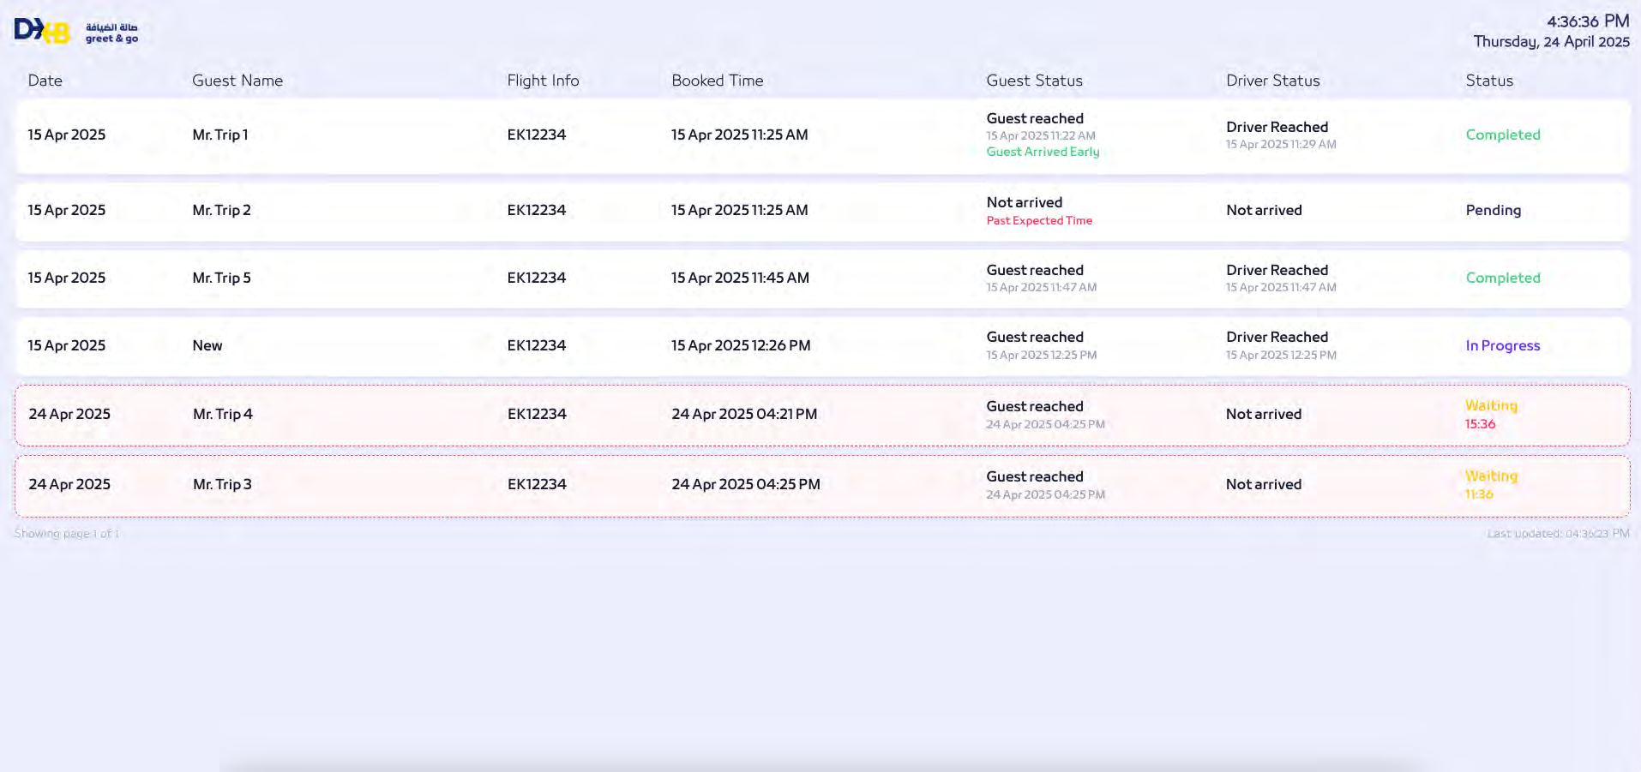
How it works
Driver arrival:
Once the driver has arrived in Terminal 3 and updates the status to ‘Arrived’ via the driver app, the same will reflect on the main Dashboard
Note:
From the time the guest has arrived at DXB Greet & Go area, at 10 mins DXB Greet & Go staff will call the driver to check his live location and if he is unable to make it, then within 5 mins from that time, then Valtrans Limousine Service will be assigned by default and original booking will be cancelled.

Slide 11

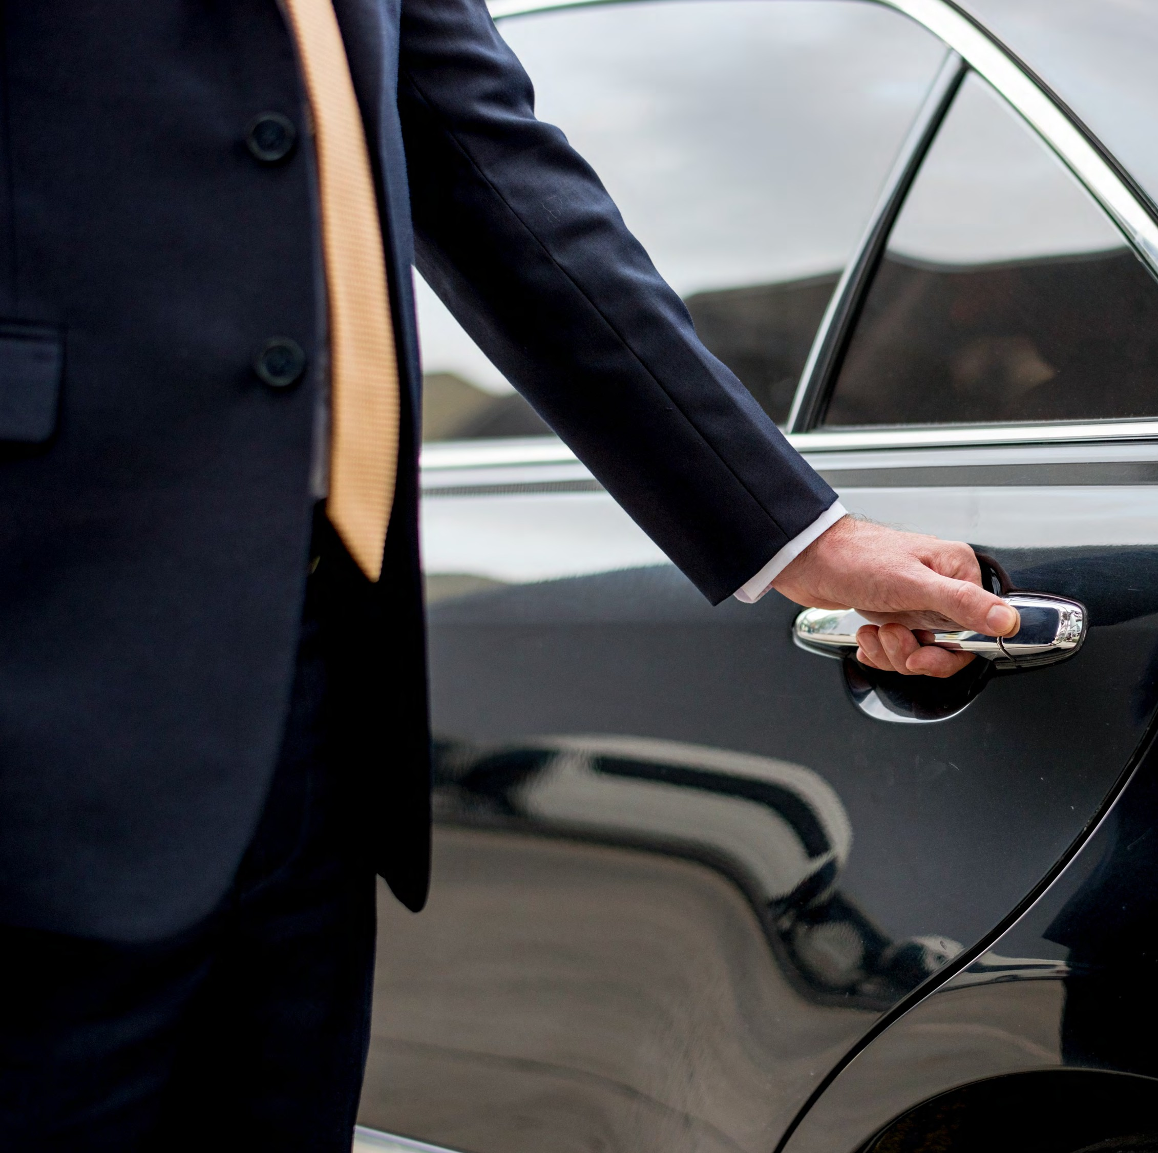


How it works
Guest transfer:
If the driver has arrived, guest will be escorted by the host from the DXB Greet & Go area directly to their registered vehicle
Meet the driver and guest:
Host will handover the guest to the driver and update status as ‘Guest arrived’ in the driver app
Service completion:
Once driver updates the status on the app, service is marked complete and the trip charges are immediately deducted from the business eWallet

Slide 12
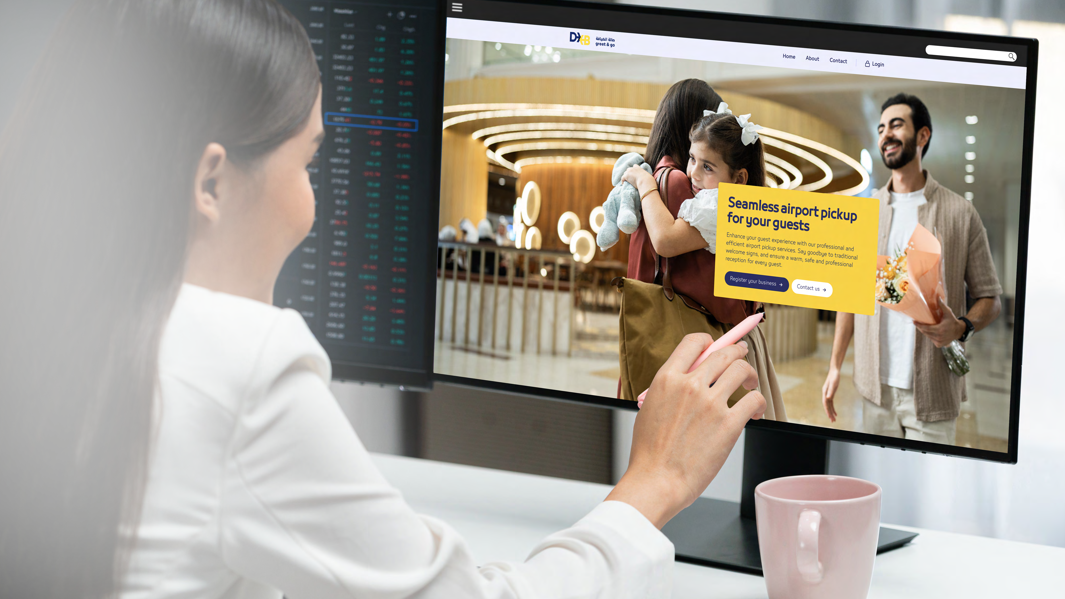

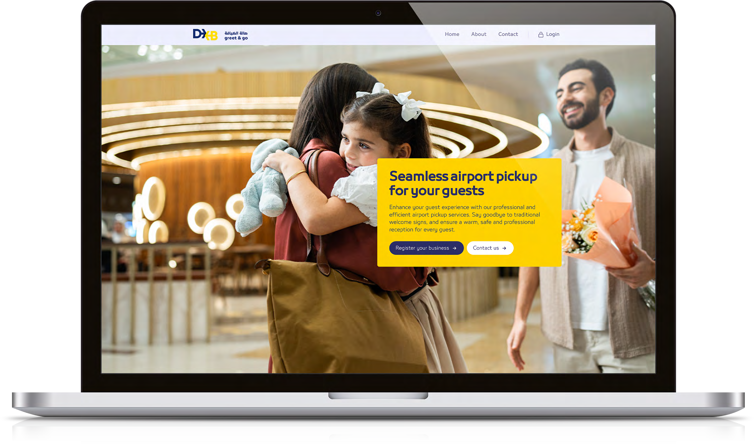

How to register
Step:
01
Visit www.dxbgreetandgo.ae
Click register your business

Slide 13
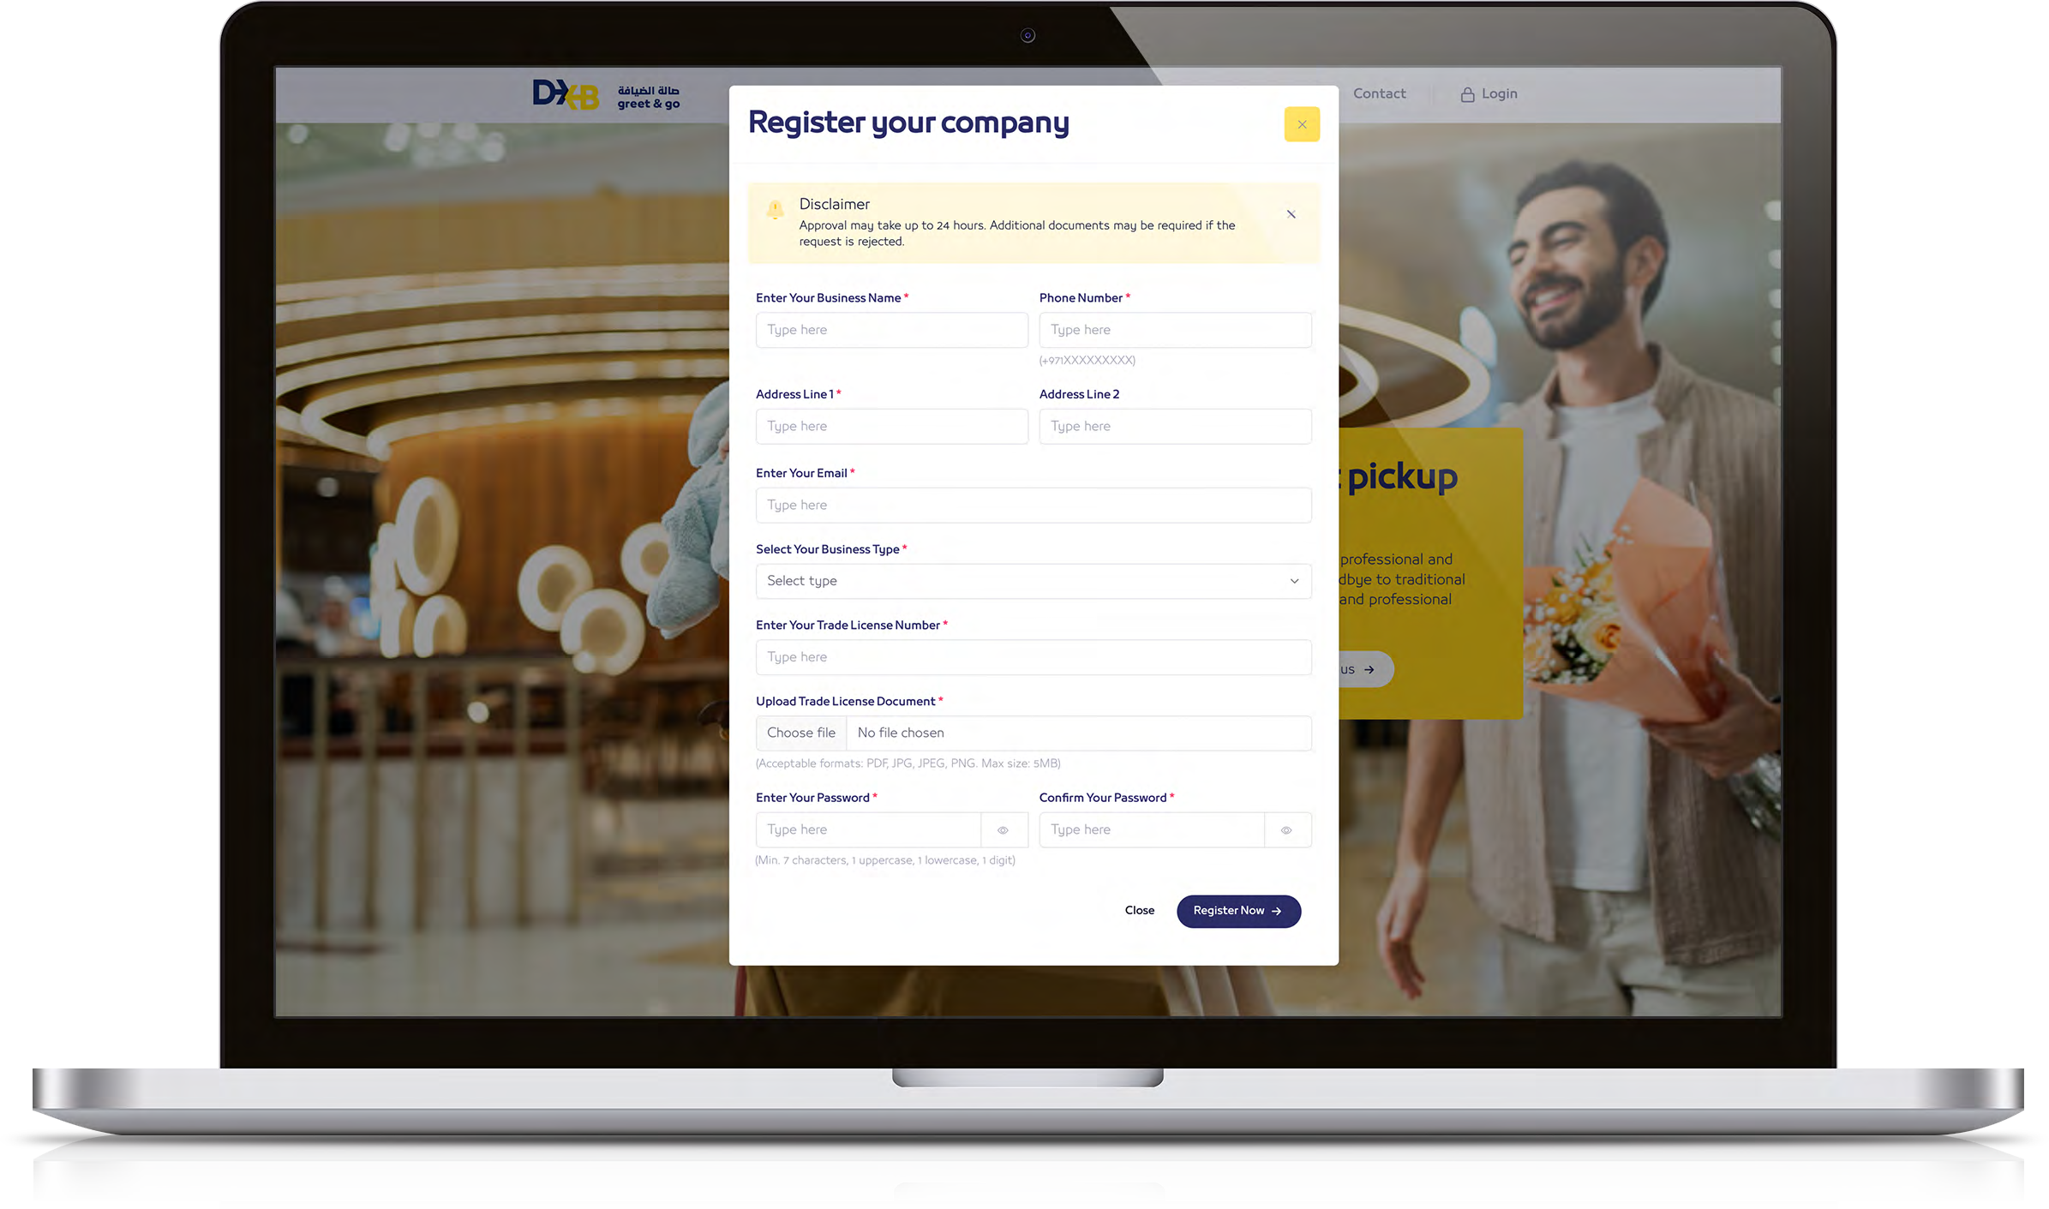
Step:
How to register
02
Complete the registration form
Provide business name
(Ensure the business name matches the trade license)
Enter phone number and email
Choose business type
(Hotel, Limousine, Tour Operator, etc)
Enter valid Trade License number and upload Trade License

Slide 14
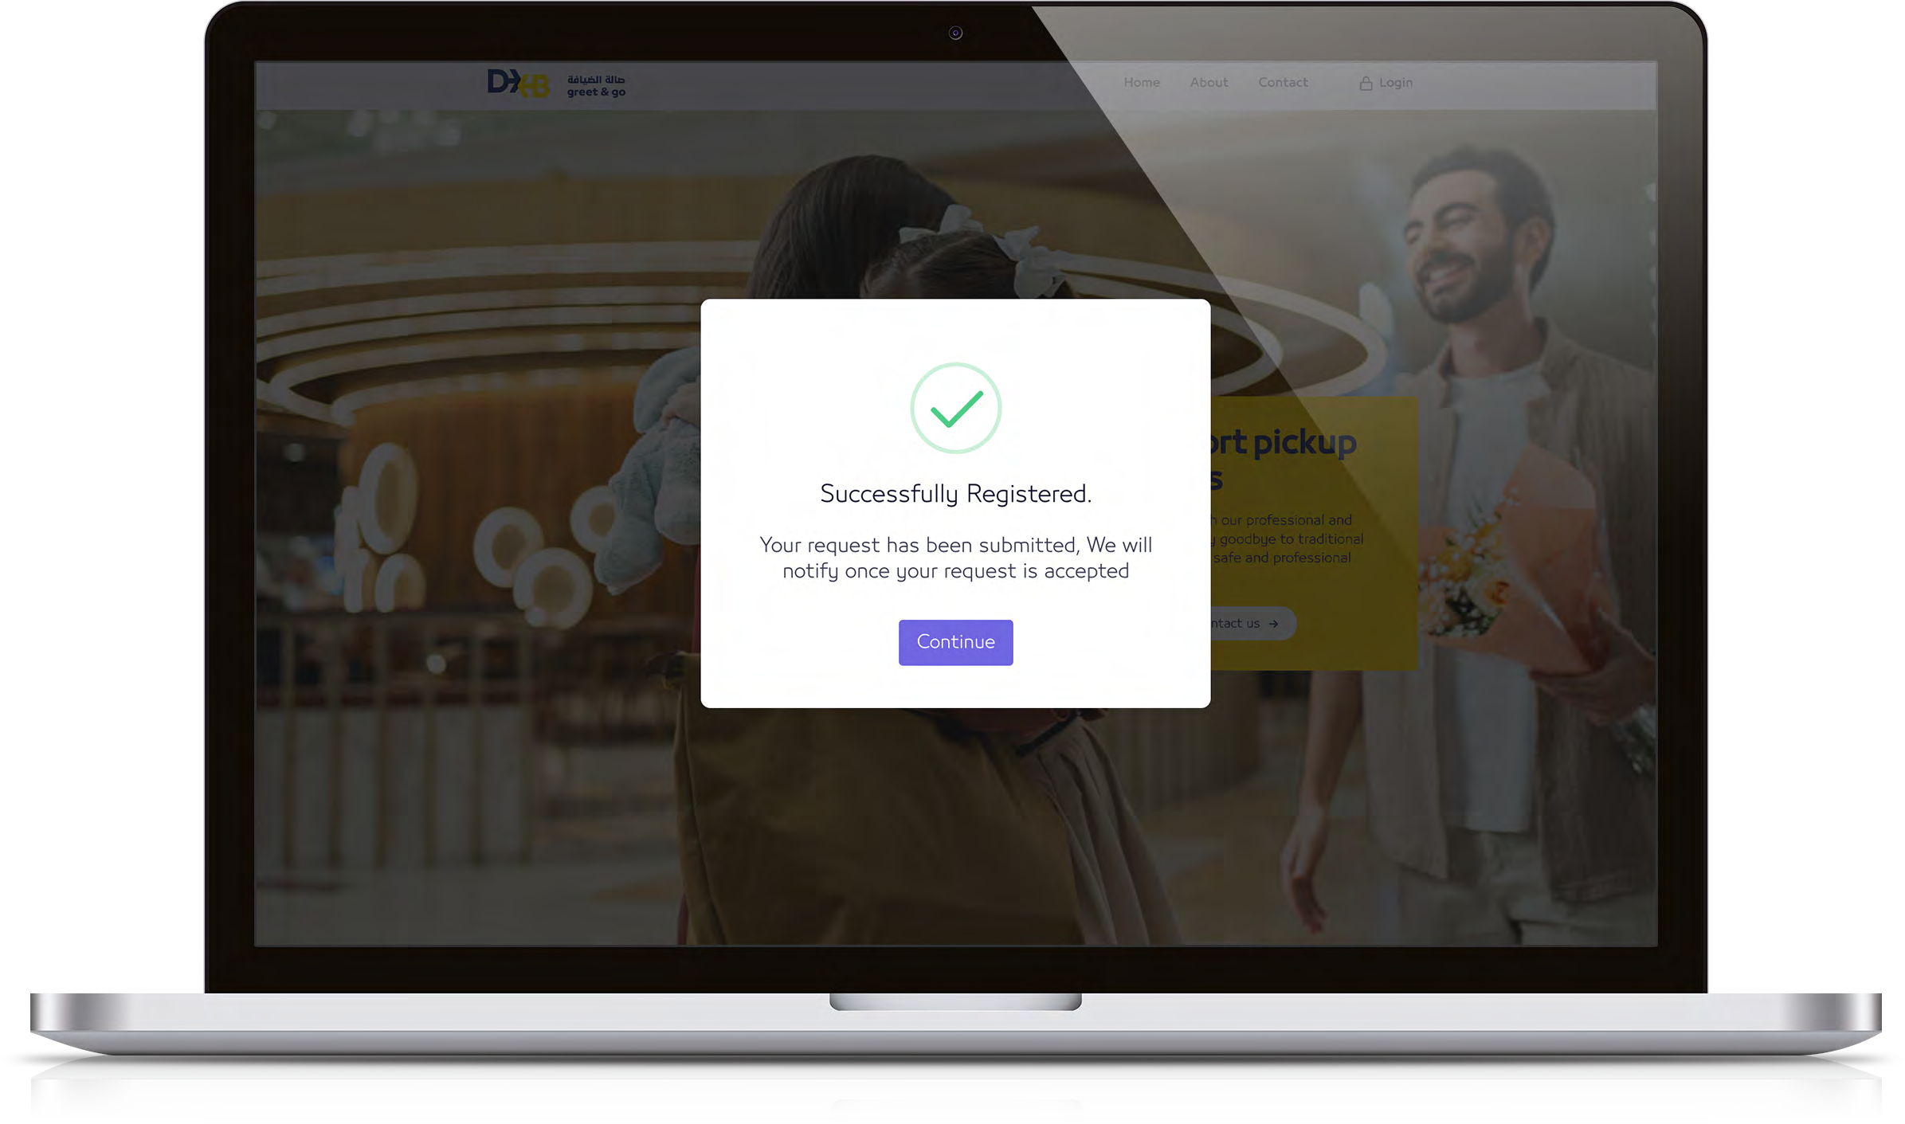
Step:
03
Wait for approval (24 hours)
Our team will review your registration details and you will be notified via email
How to submit documents:
Use the link received via email with the reference number to upload your files.
If your business registration request is rejected, an email will be sent with a link to upload additional documents

Slide 15
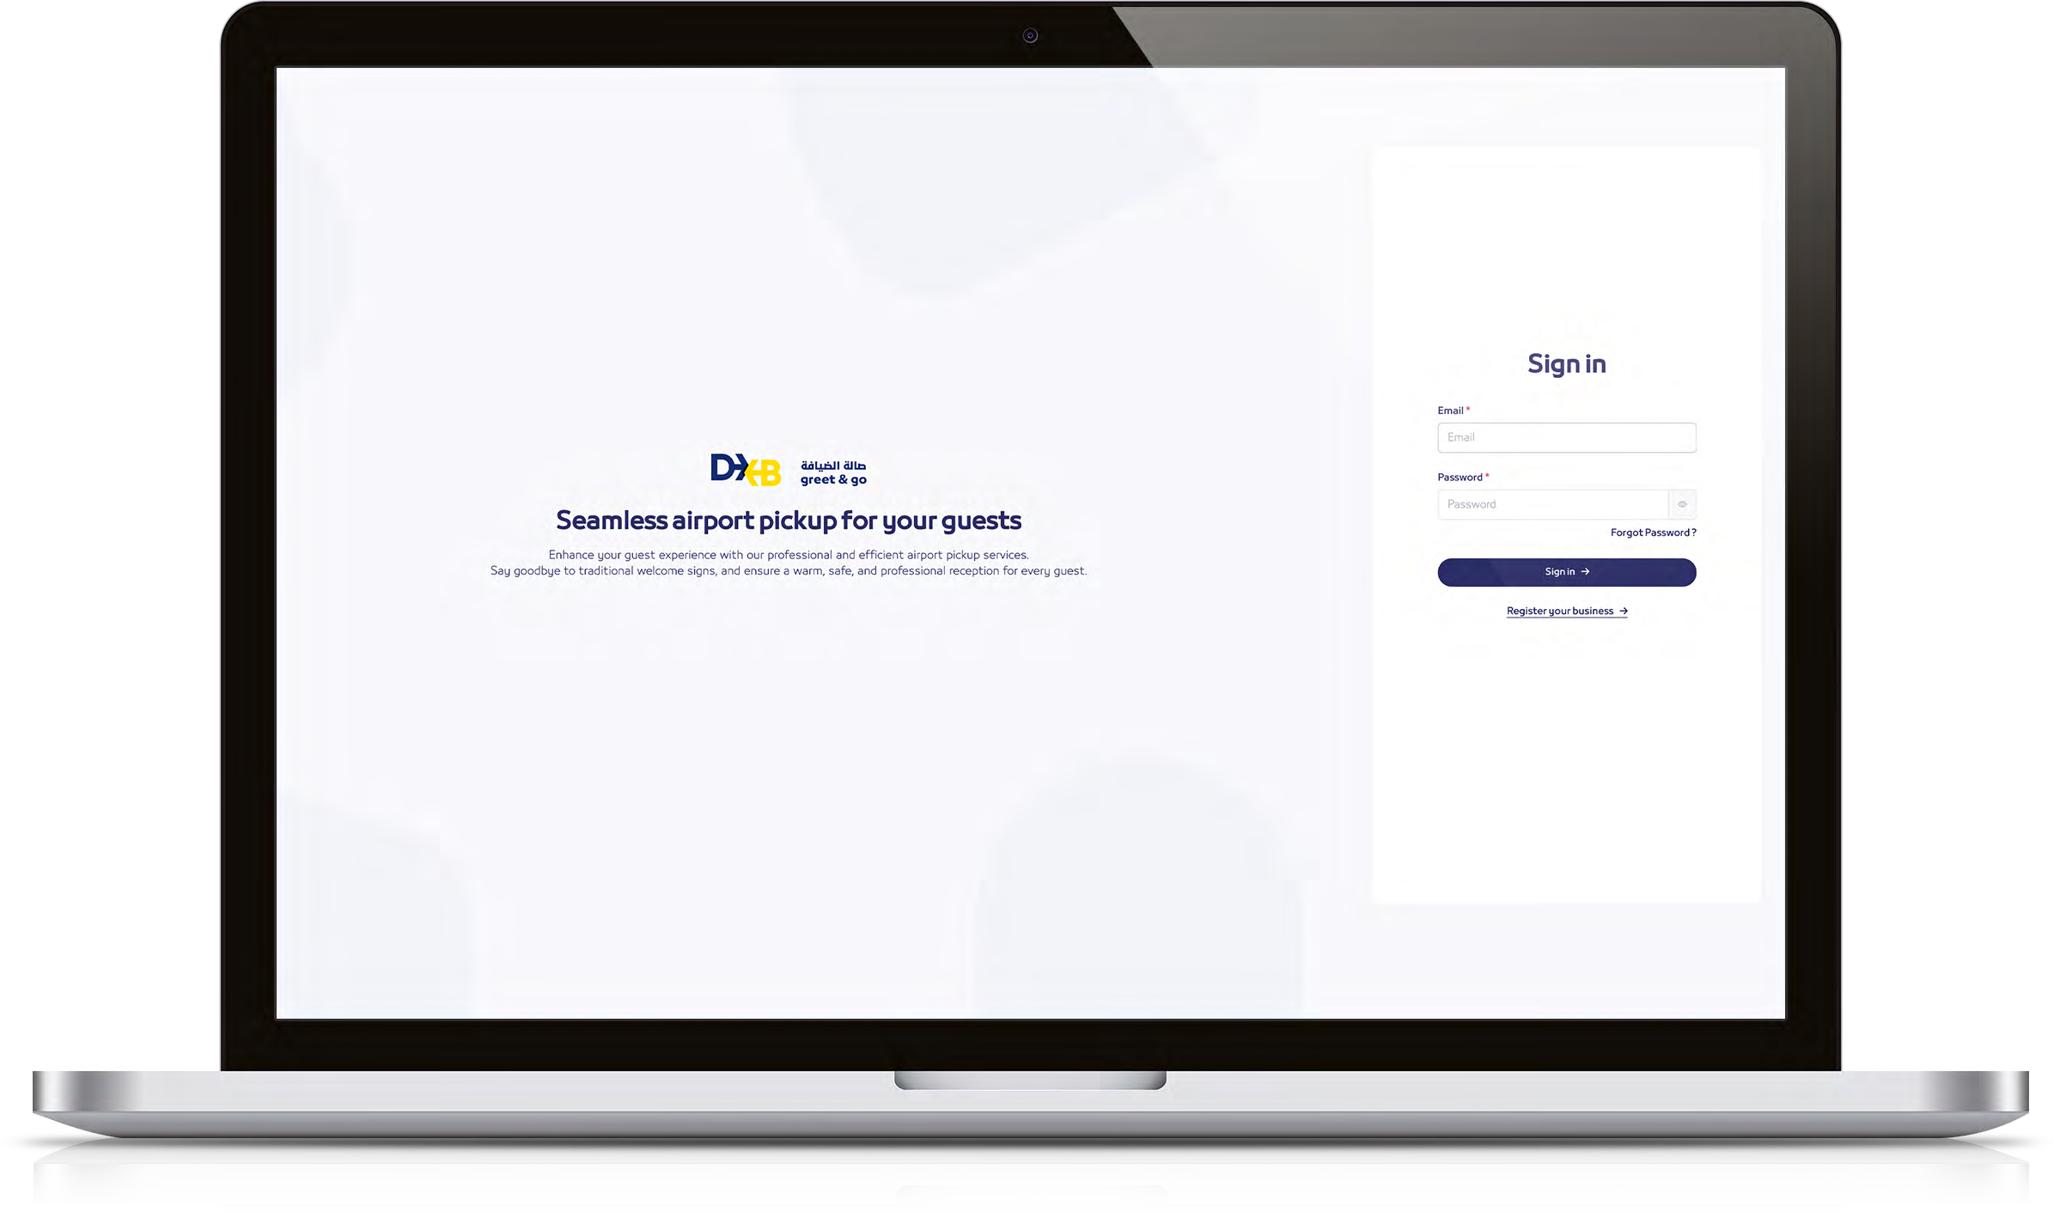

Account approval
Your account will be approved upon completion of verification process which will then allow you to log in using the registered email and password provided at the time of registration.
https://dxbgreetandgo.ae/sign-in

Slide 16
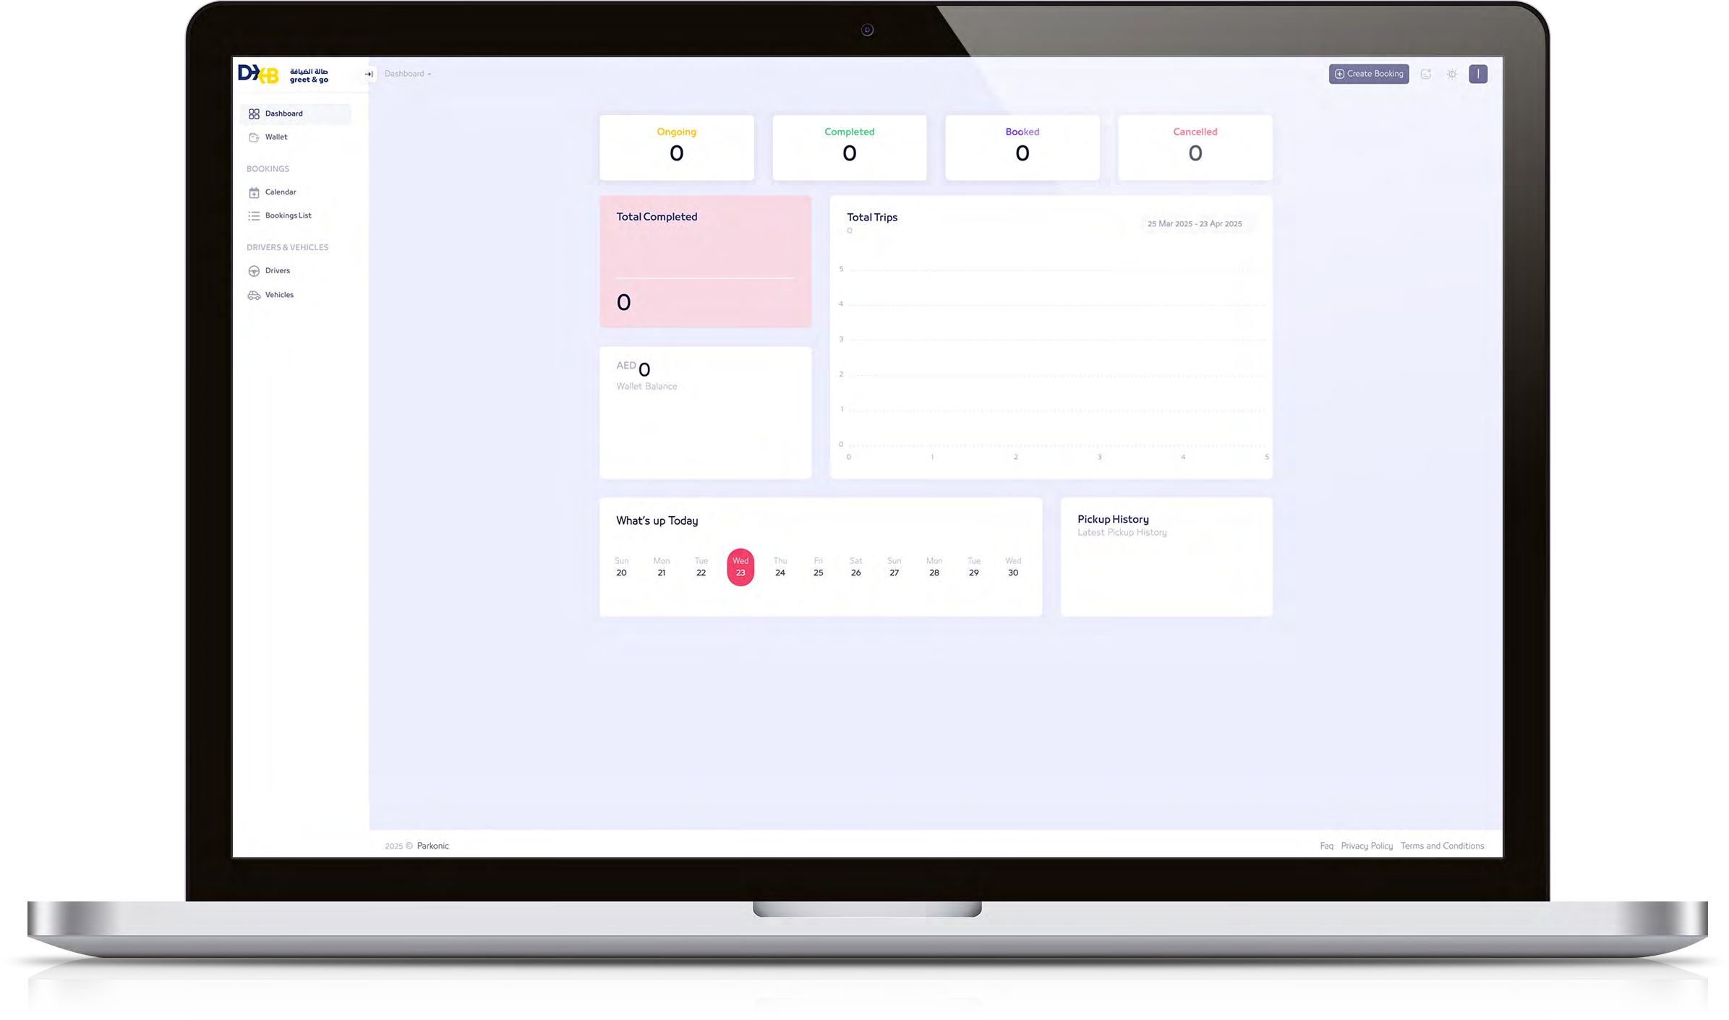
Dashboard
Gives you all the information to book a service, check your upcoming and past bookings, access reports, top up your eWallet etc.

Slide 17
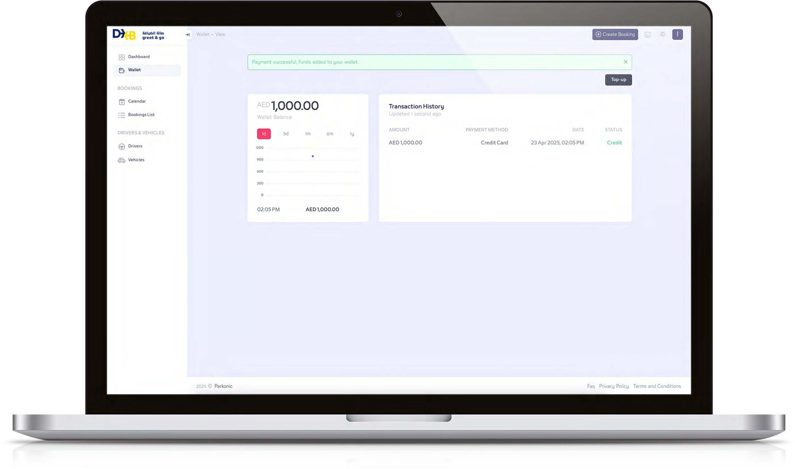
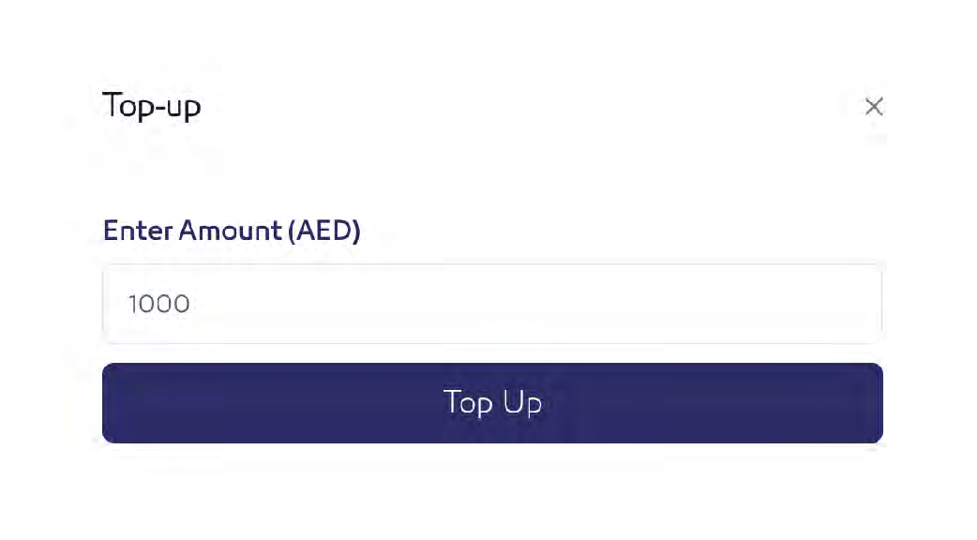
eWallet top-up
Each business must maintain a minimum eWallet balance of AED 1000, we recommend doing a higher top up.
VAT will be applicable on each top up

Slide 18
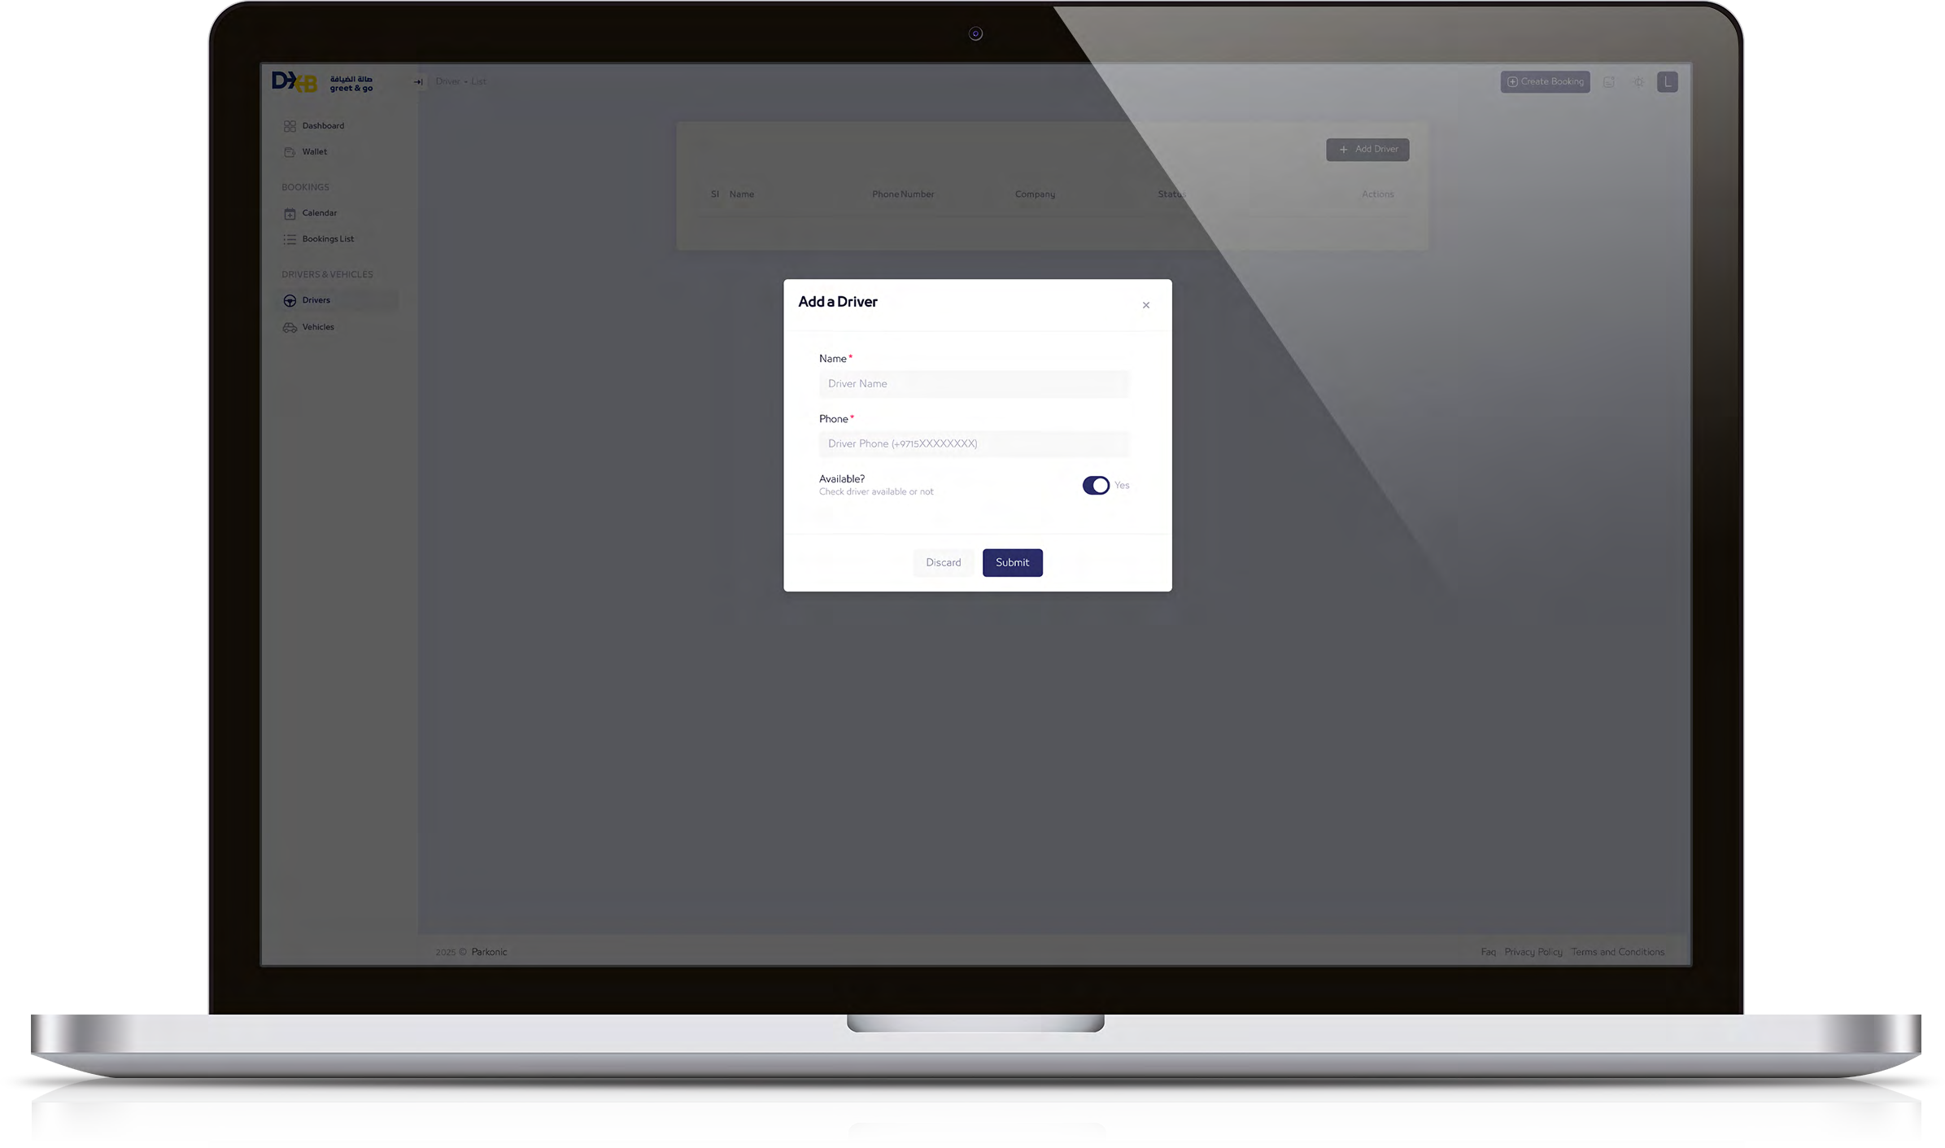
Add driver & vehicle details
Please provide your driver's details, including their contact number and availability.

Slide 19
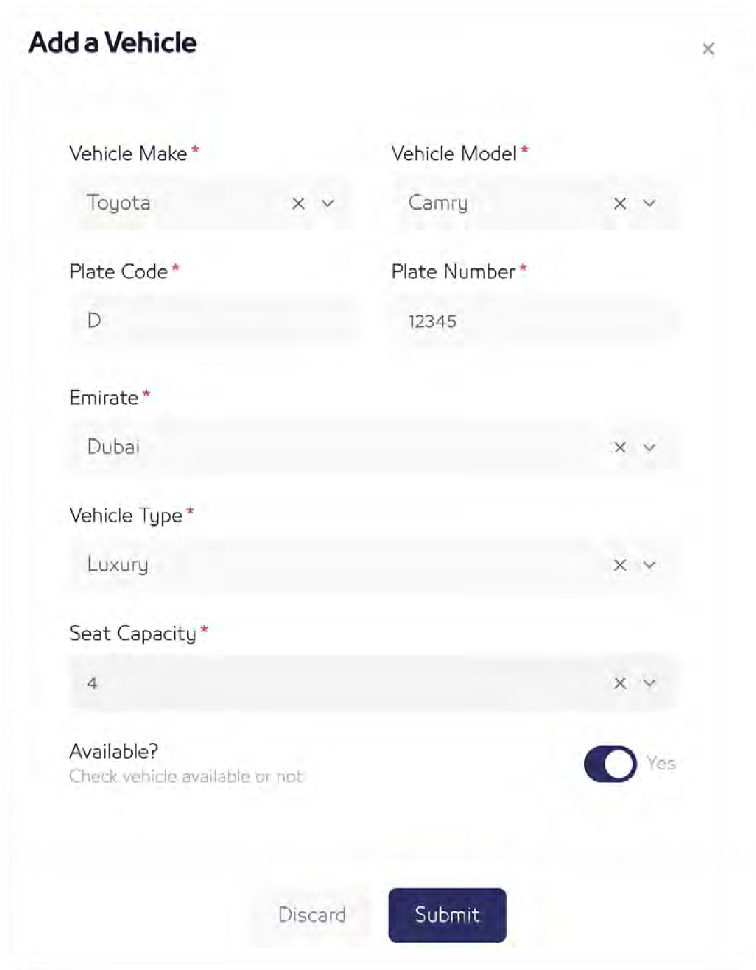
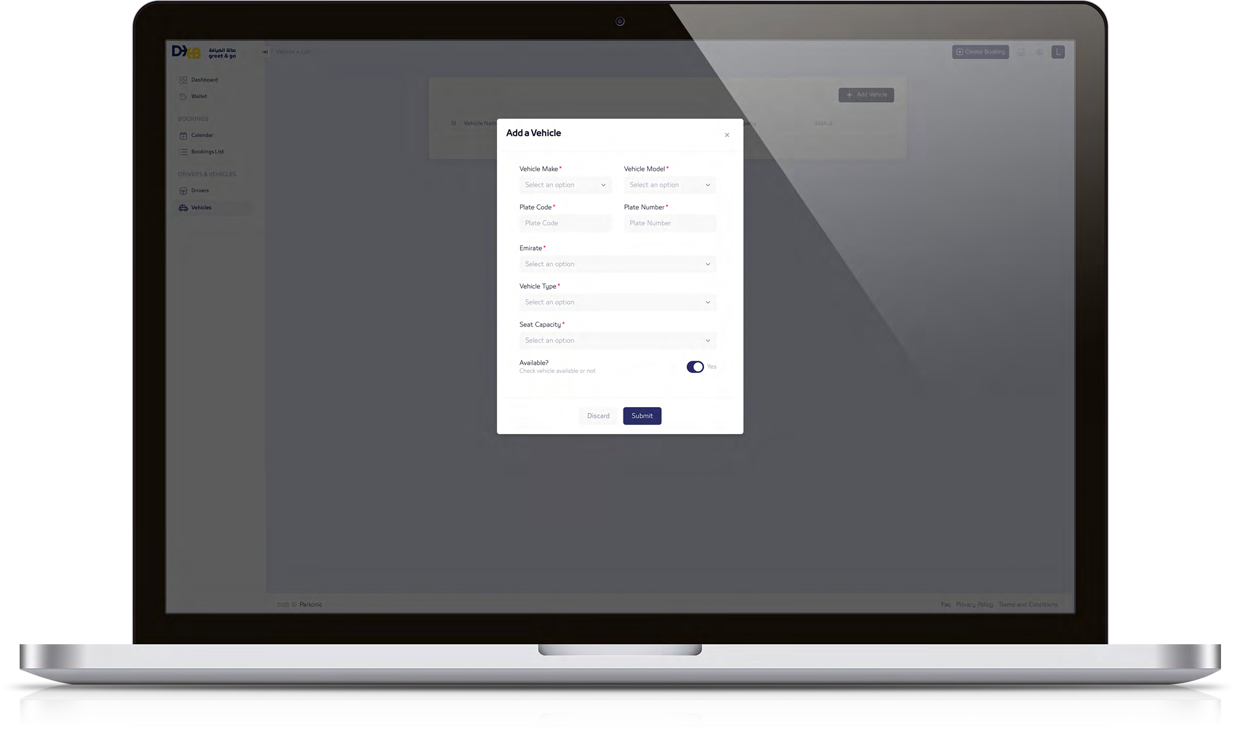
Add driver & vehicle details
Please provide your vehicle details, including:
Make and model
Registration information
Vehicle type
Seating capacity
Availability can be updated later if needed

Slide 20
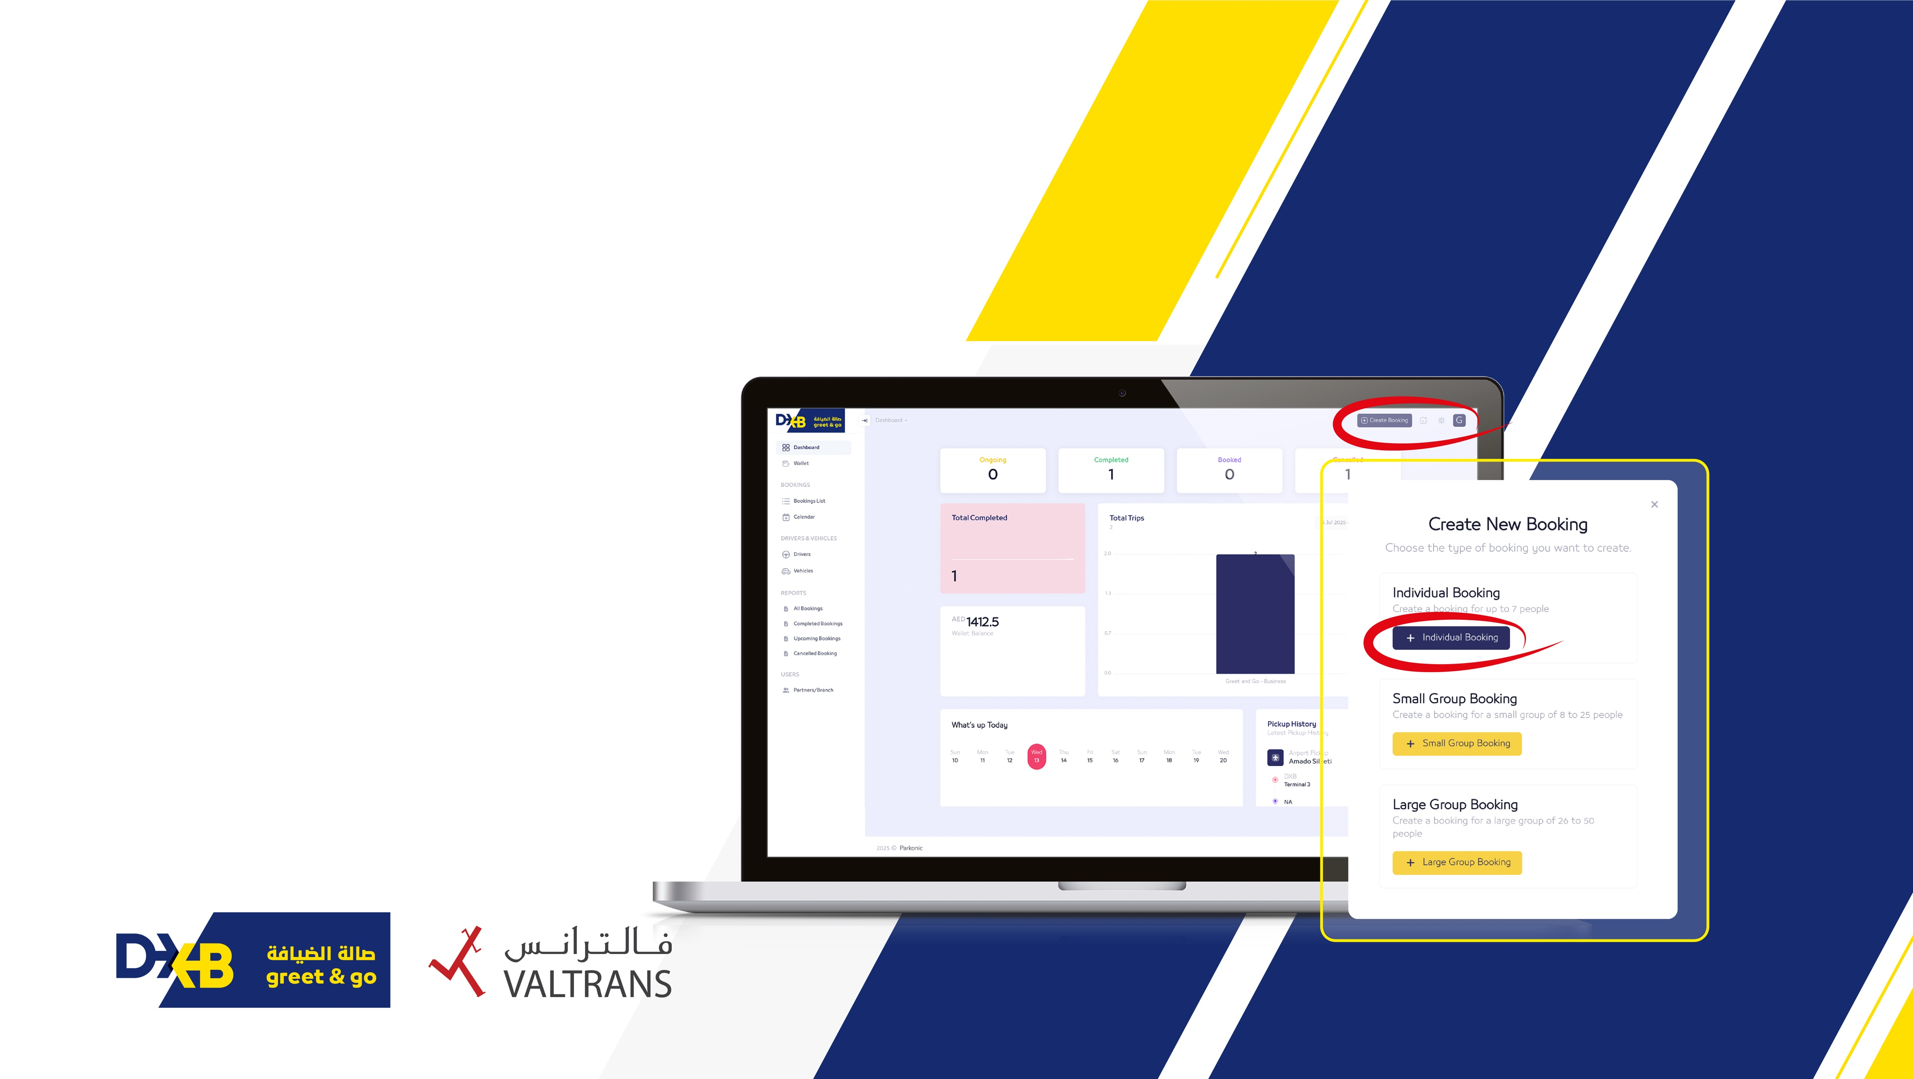
Booking methods
Option:
01
Pick-up with your
own cars & driver
Individual Bookings - Fill in the guest information, including the number of guests, flight details (time, date, and flight number)
Small & Large group: Fill in all the information as above in addition system requires all guests names( mandatory field)
You can assign a group name and mention only one point of contact (coordinator/driver name & number)
Click add Driver / Vehicle Button
Choose your available Driver and Vehicle
Click Submit

Slide 21
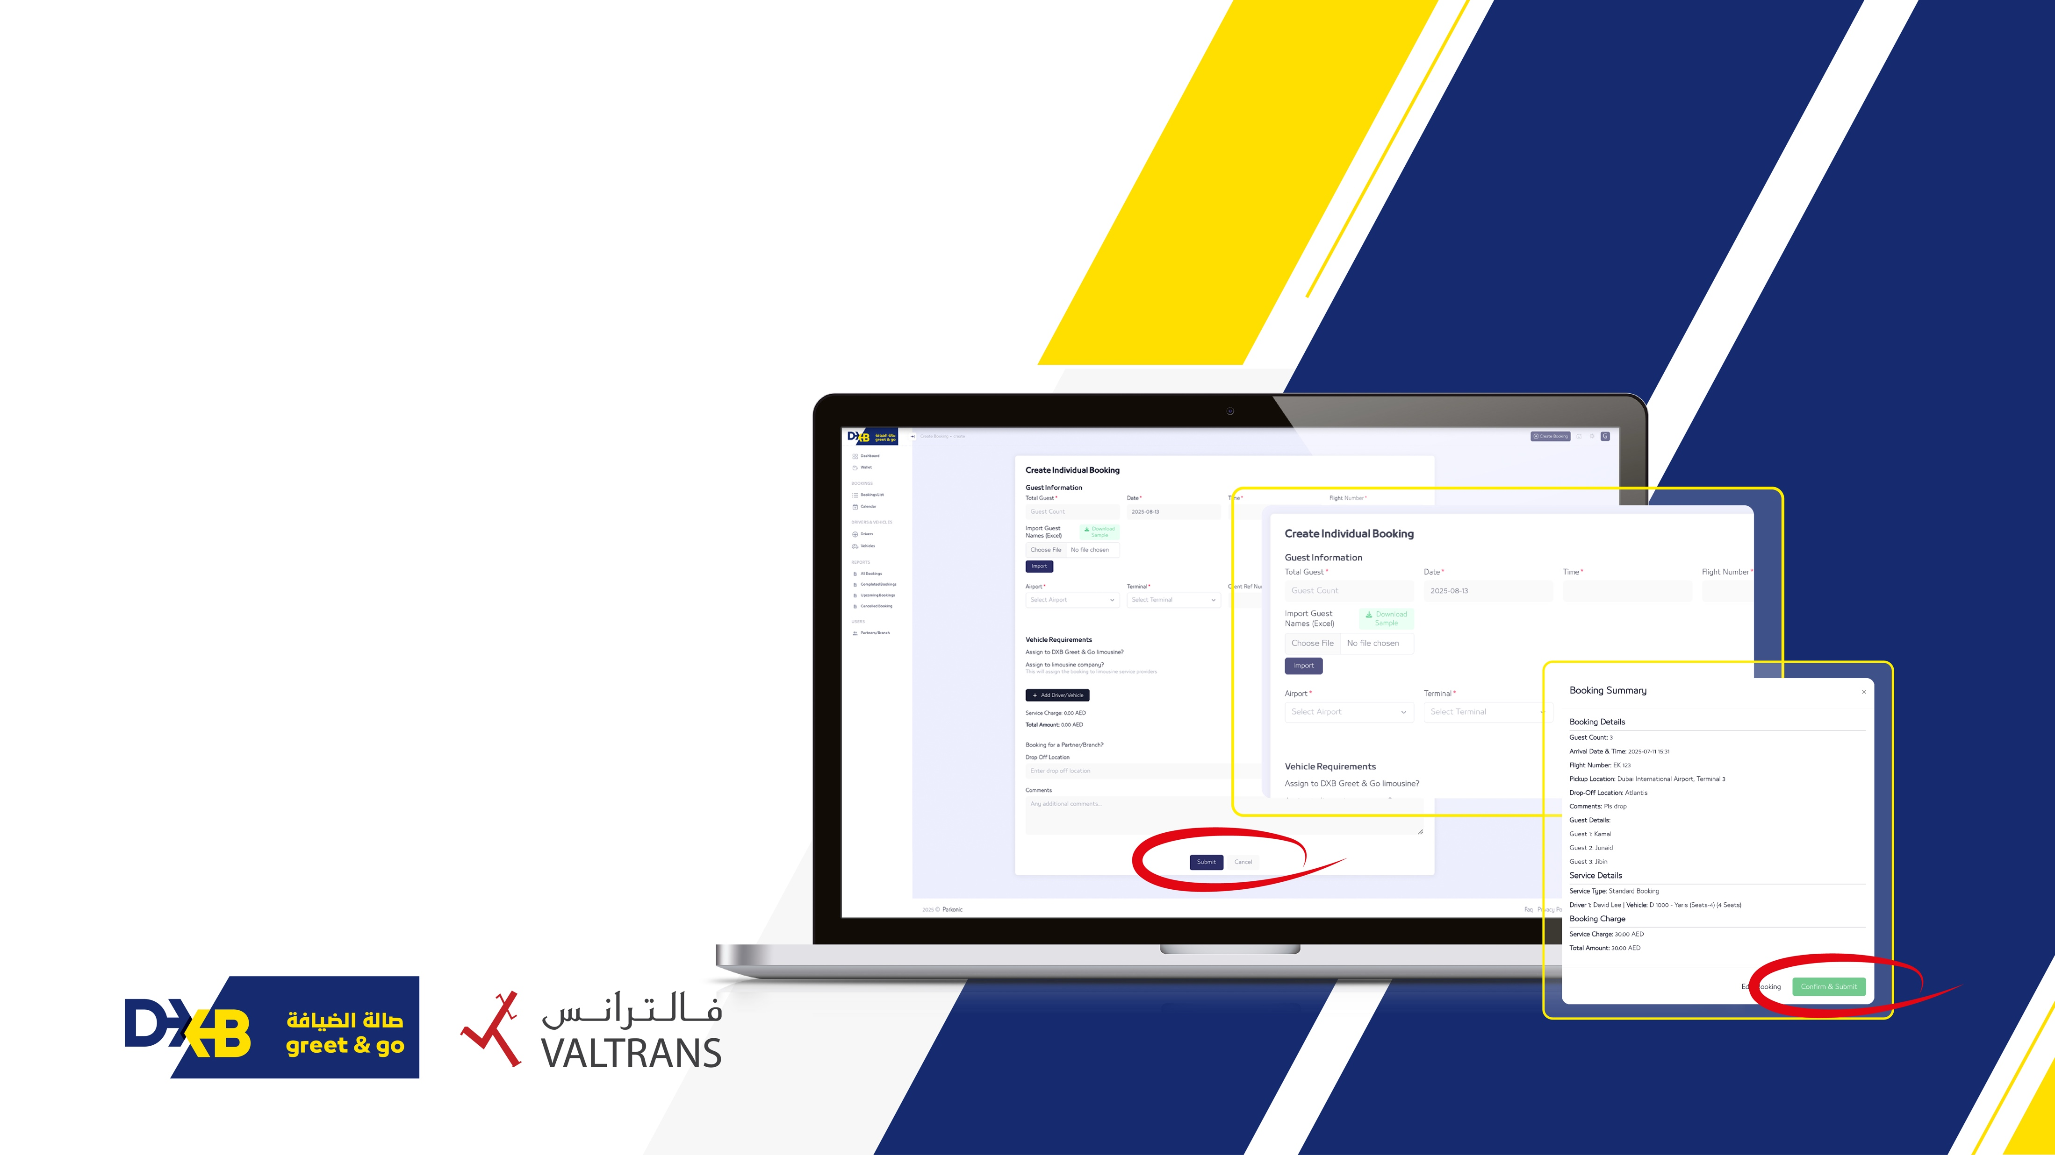
Booking methods
01
Create Individual Booking

Slide 22
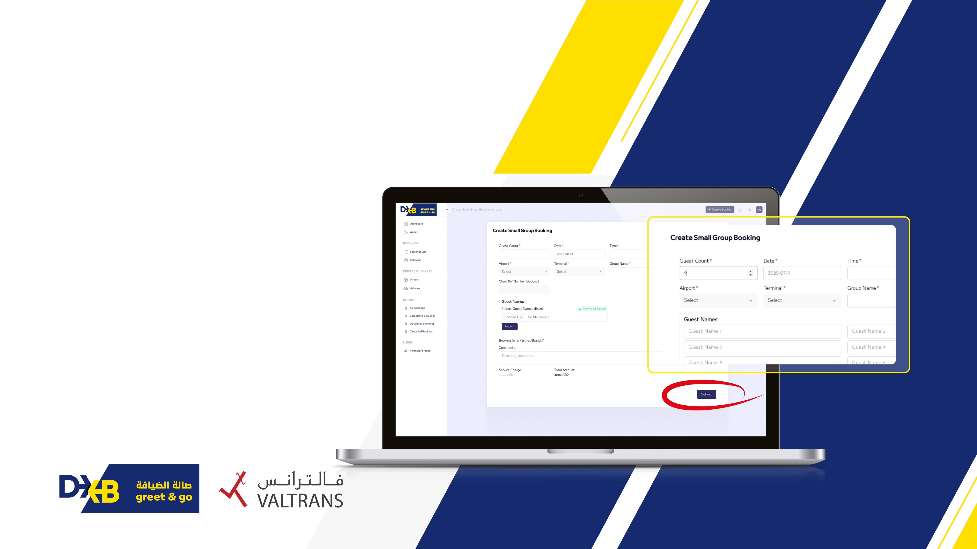
Booking methods
02
Create Small Group Booking

Slide 23
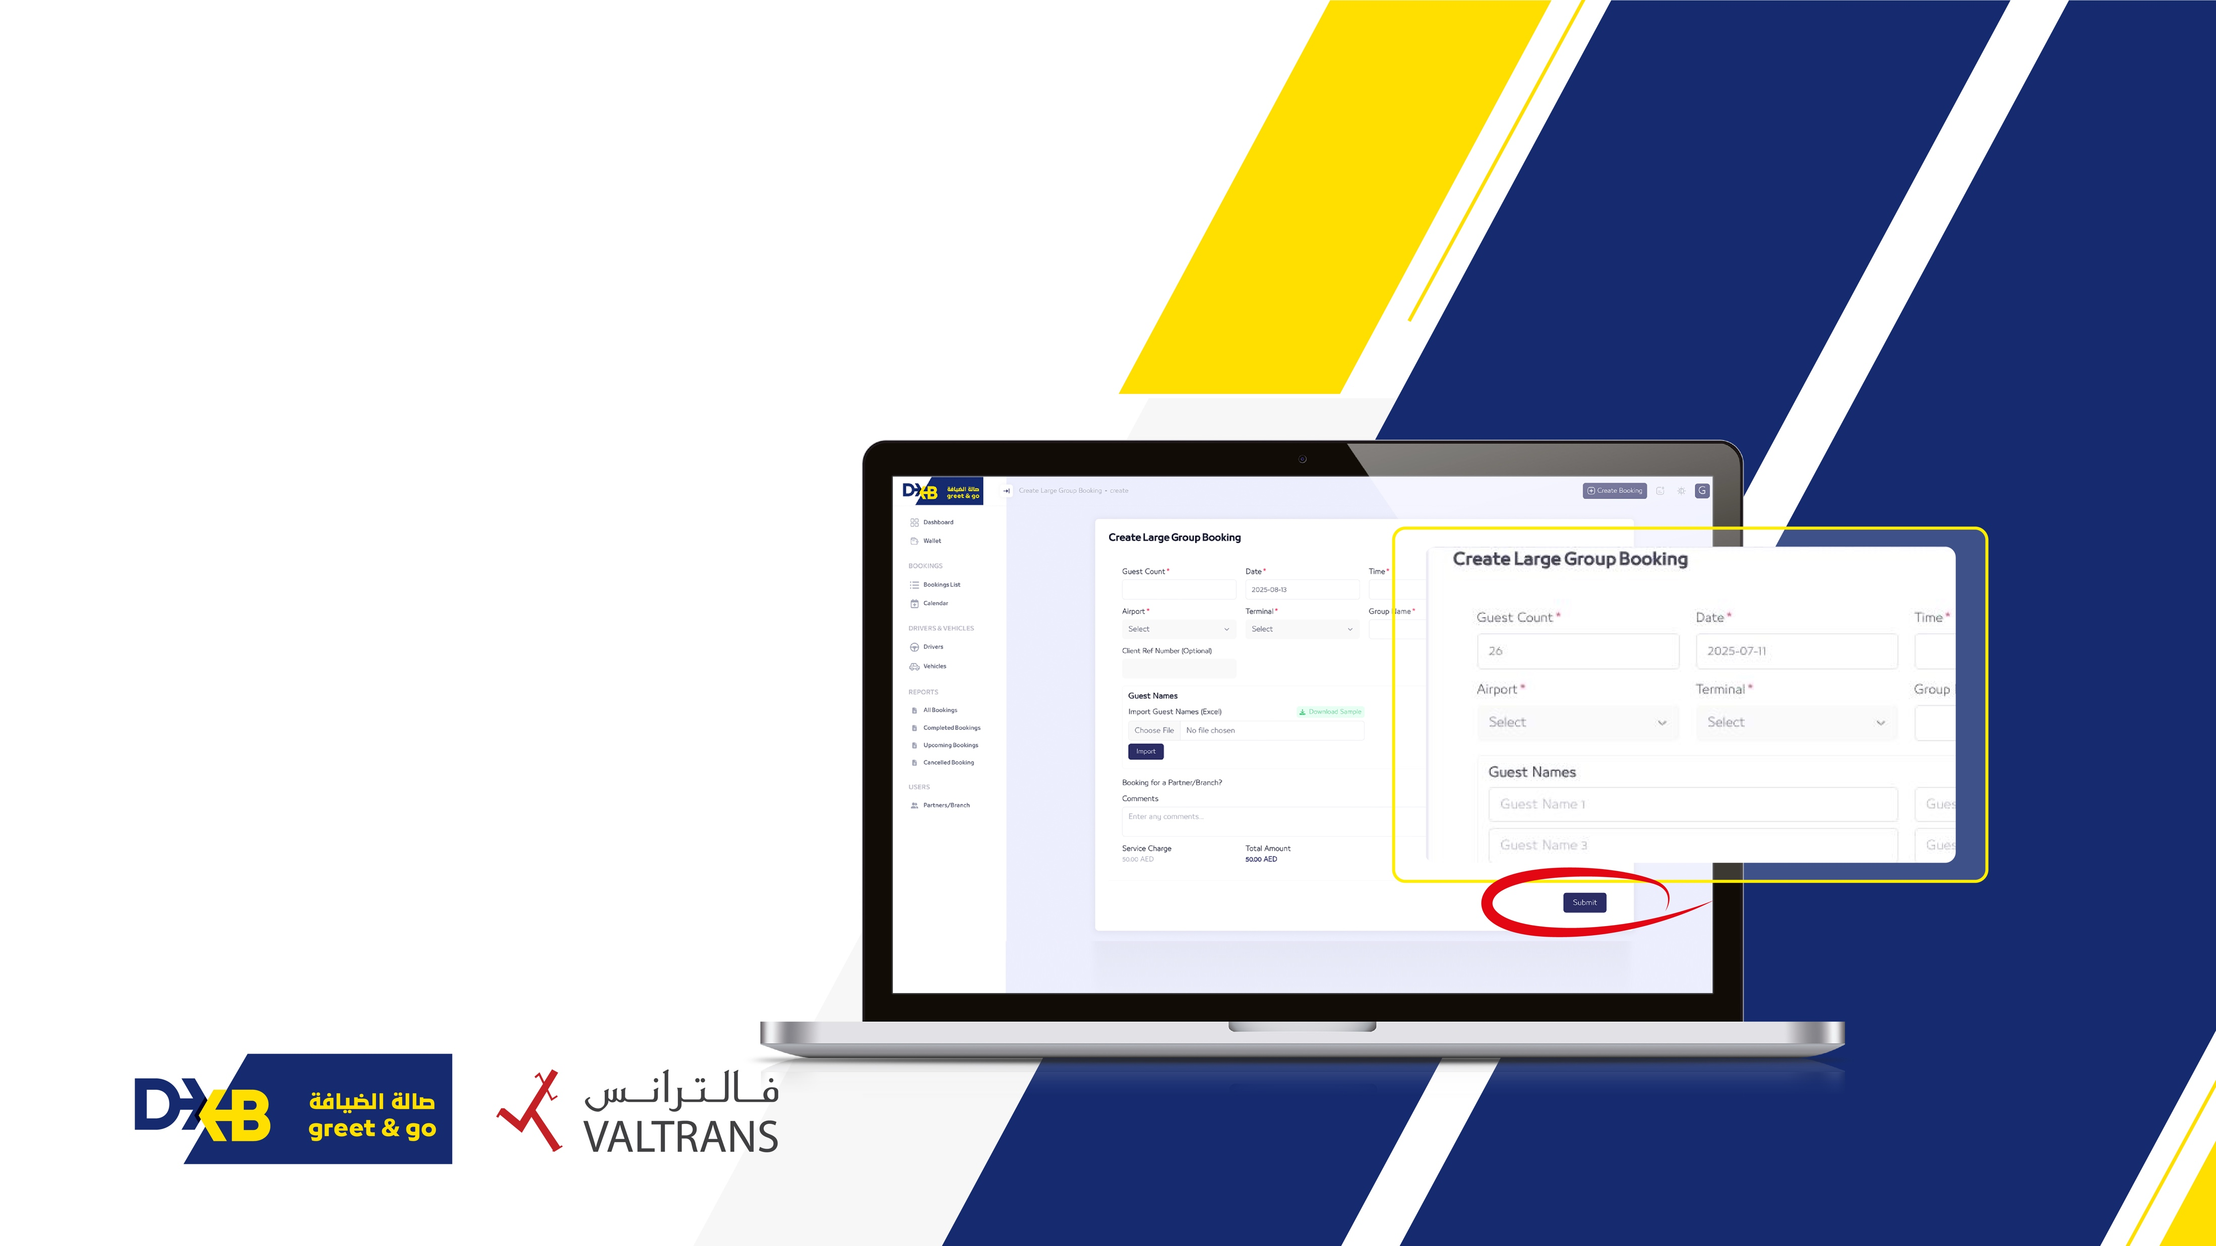
Booking methods
03
Create Large Group Booking

Slide 24
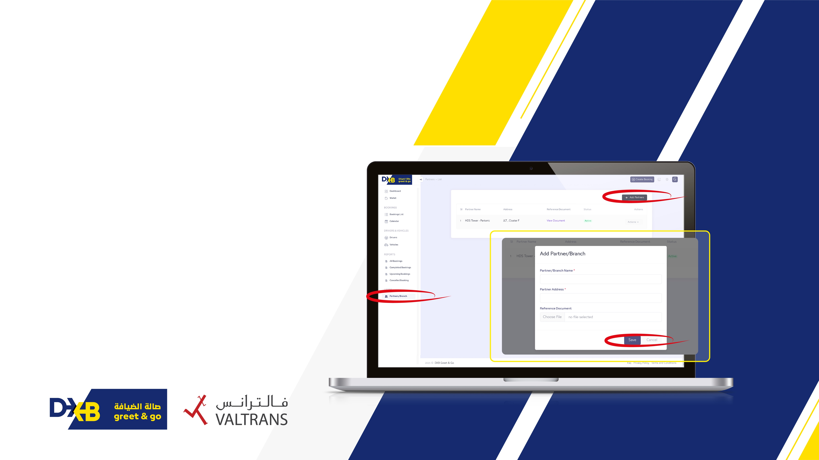
Manage Multiple Business under one account

Slide 25
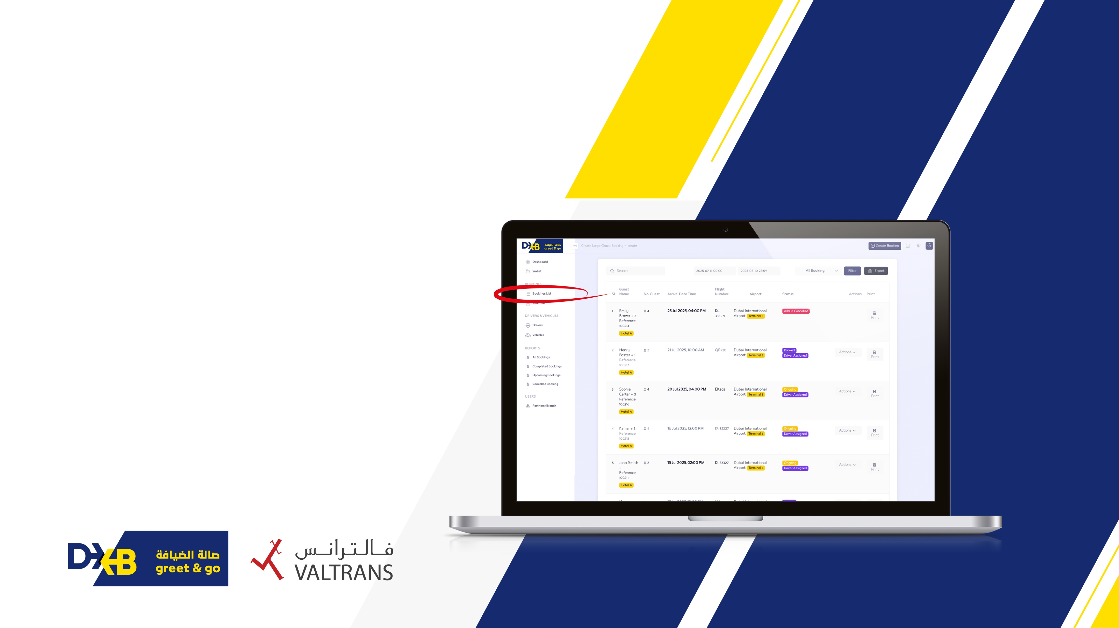
Booking List

Slide 26
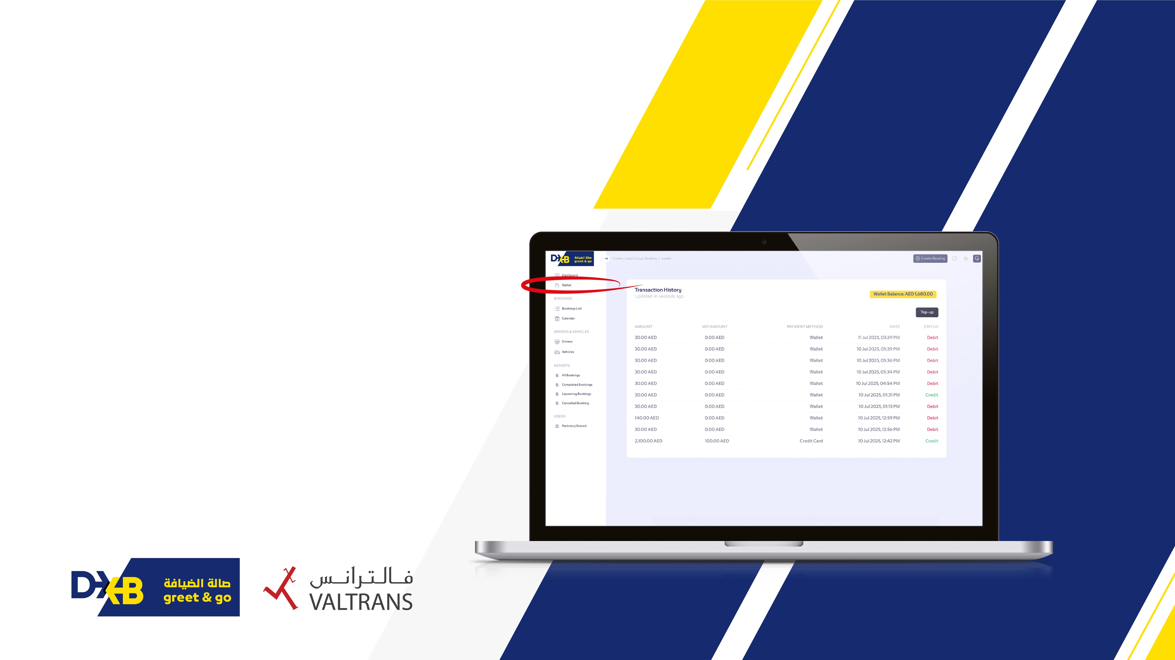
Transaction History

Slide 27
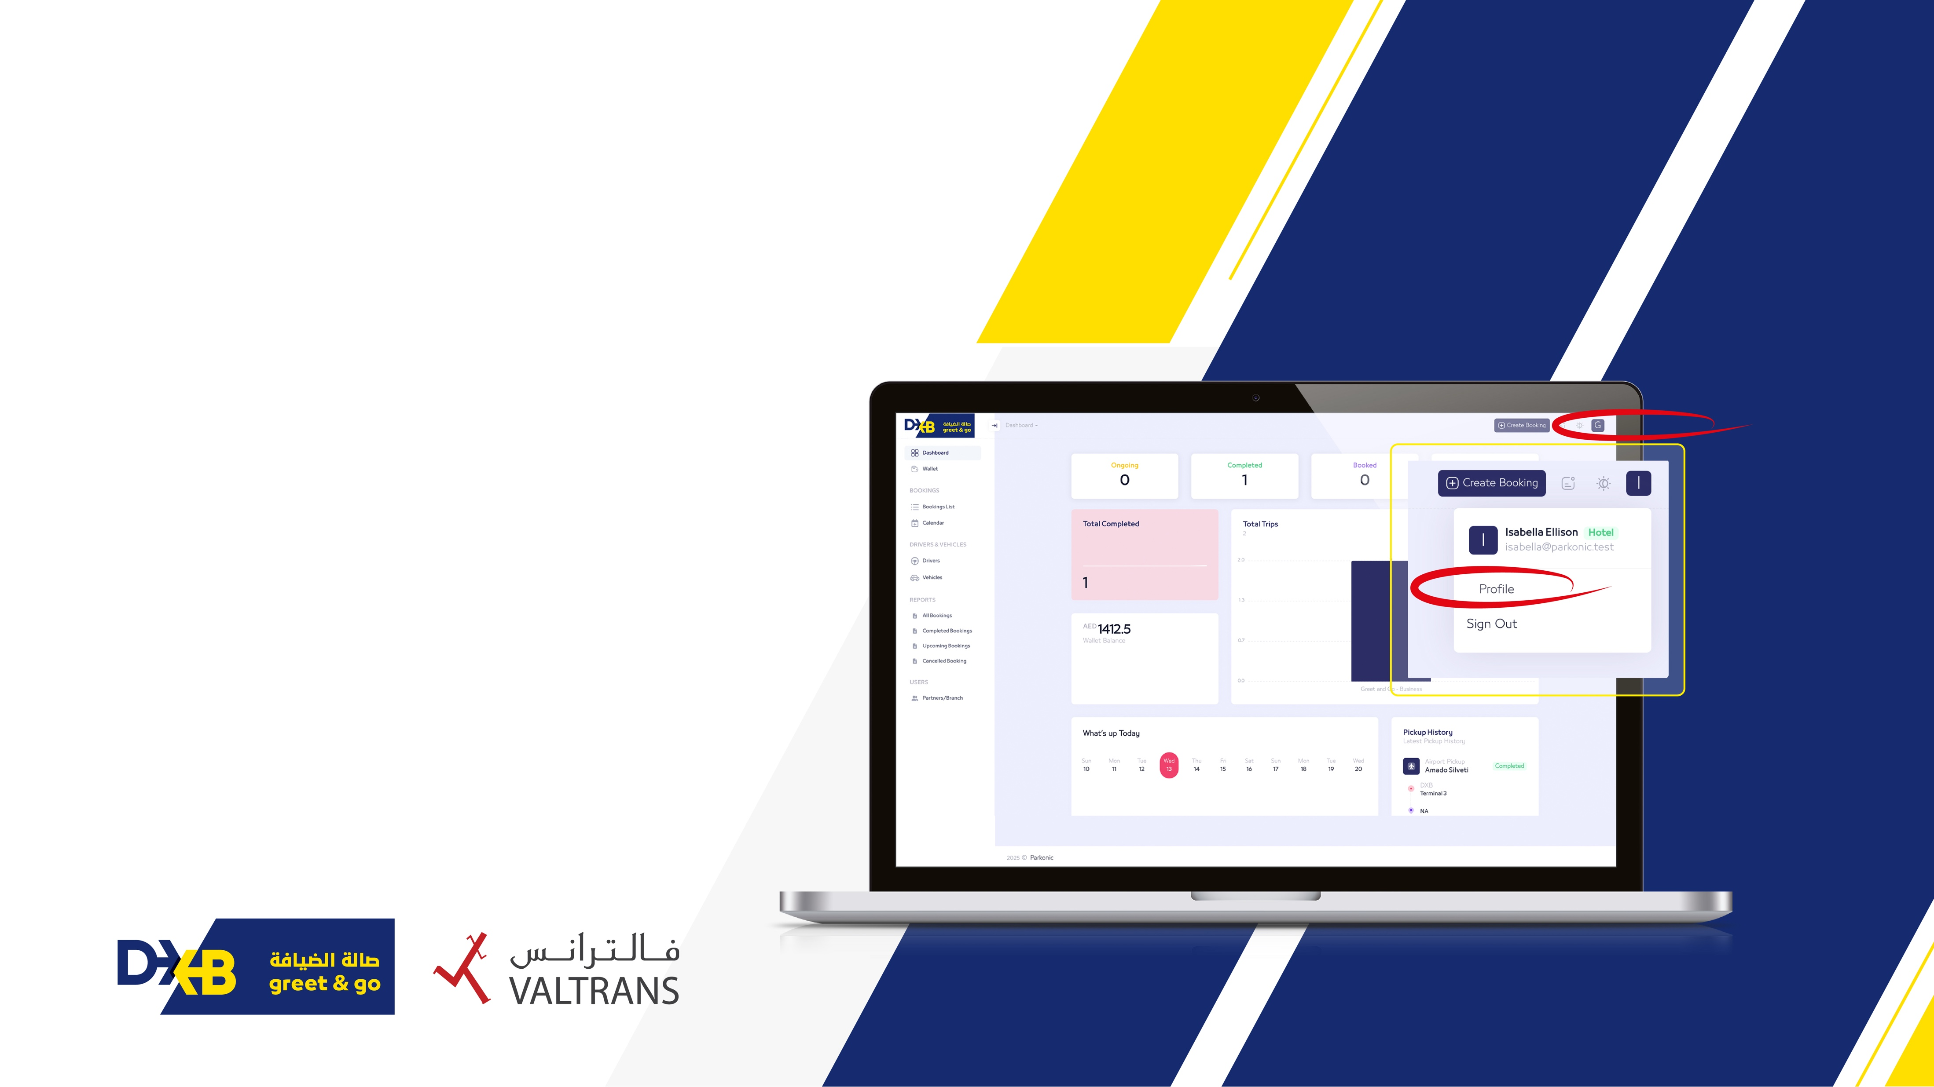
Booking methods
02

Slide 28
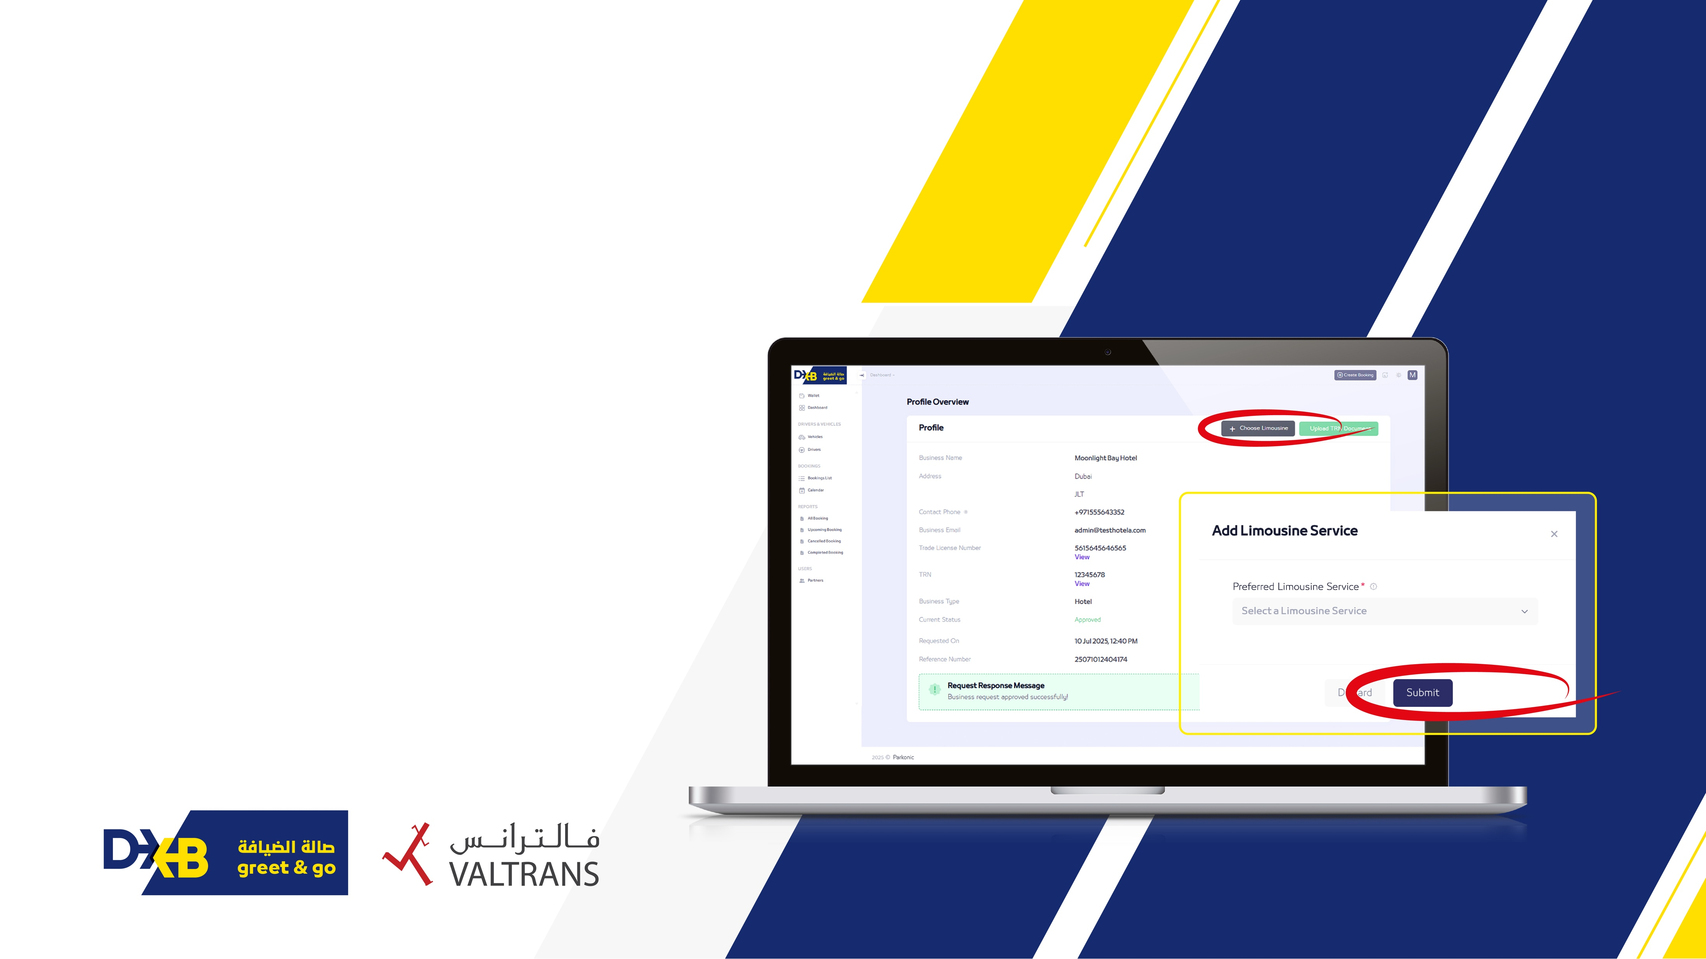
Booking methods
Click the Choose Limousine button
A list of limousine companies your organisation has contracts with will appear
Select the appropriate company from the dropdown list
Click the Submit button to
complete the linking process

Slide 29
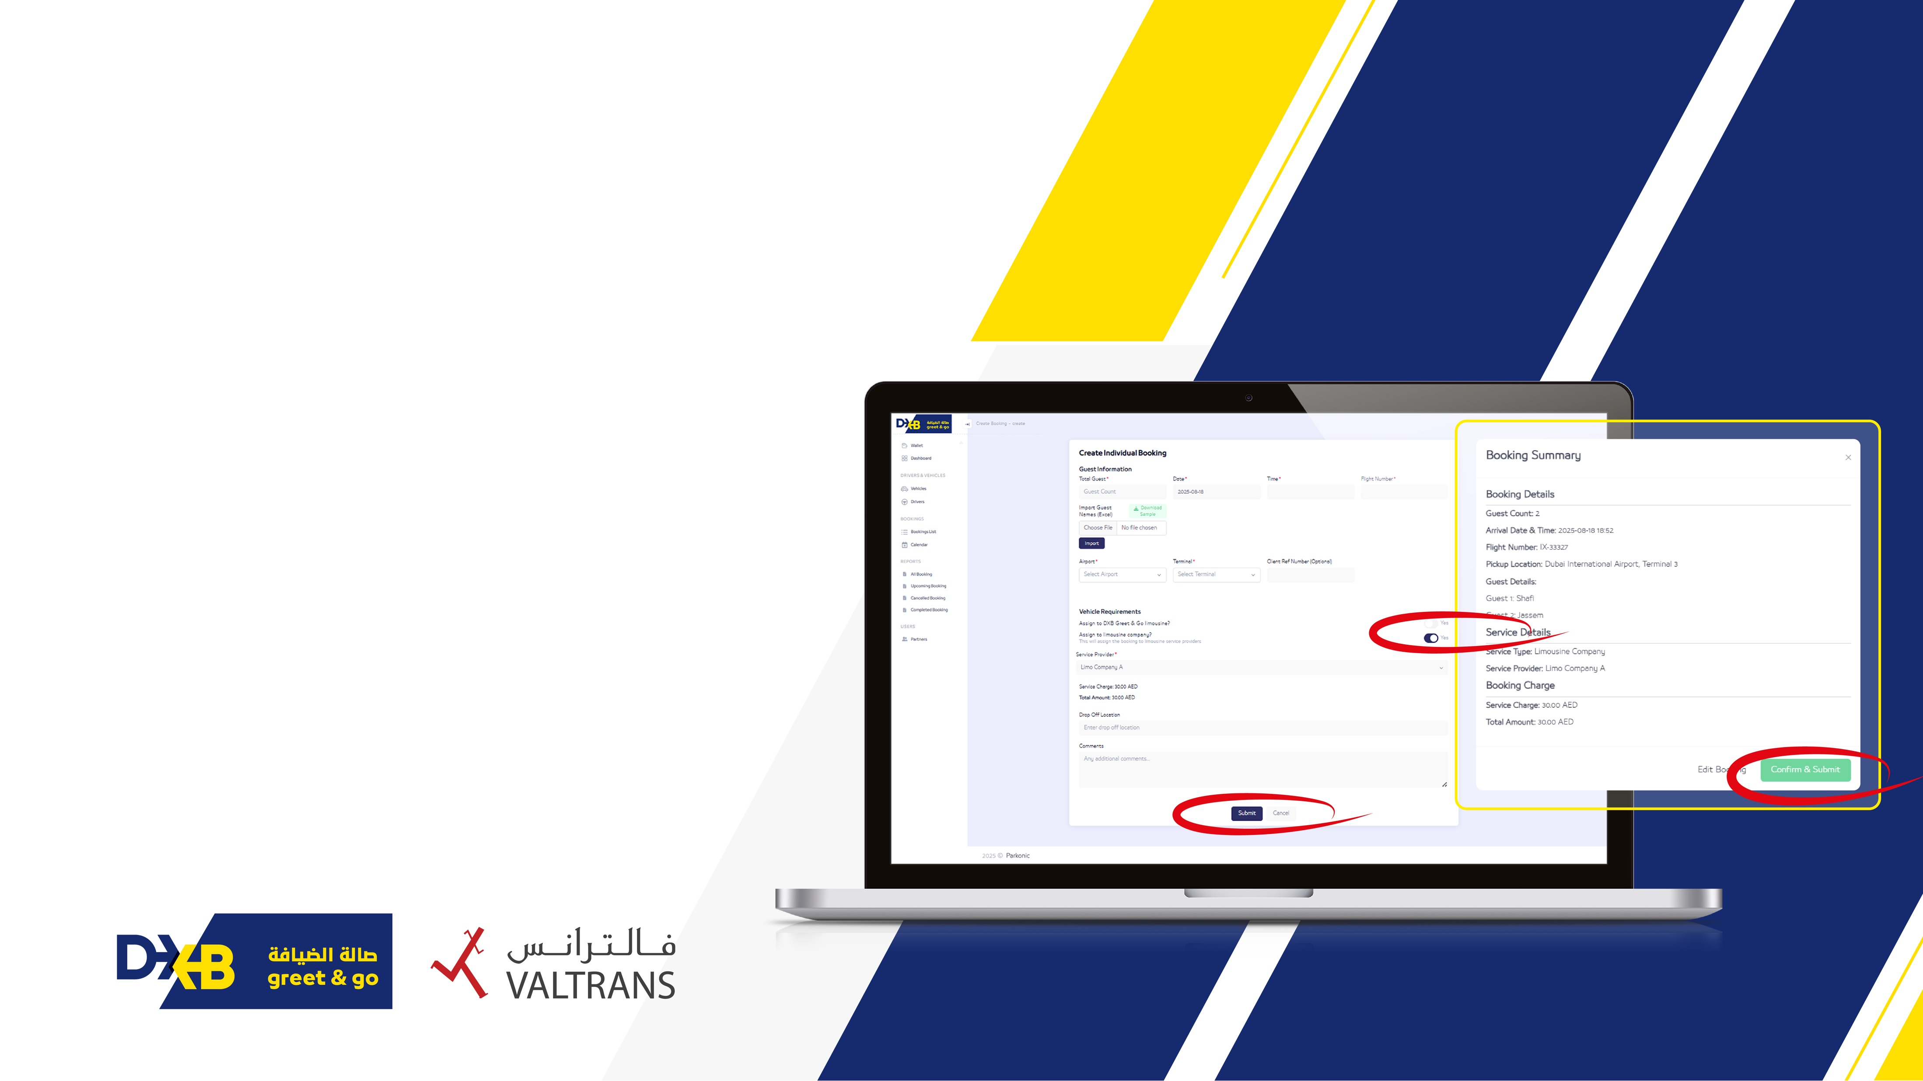
Create a booking and assign to
contracted limousine companies
Once the company is linked, go to the
Create a booking section in the portal
Fill in the guest information, including:
Number of guests & flight details
Enable the Assign to Limousine Company
toggle
Select the linked limousine company from the dropdown list
Click Submit to complete the booking

Slide 30
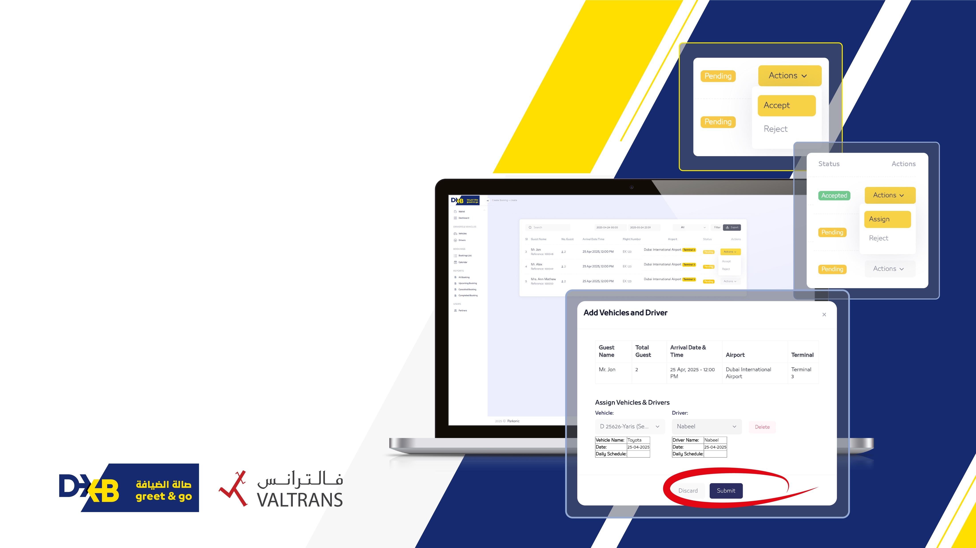
What happens next
Once the booking is created, limousine company receives a notification via email
They log in to their portal to review the booking details
The request will be accepted or rejected
If accepted, they will proceed to assign a driver to the booking

Slide 31
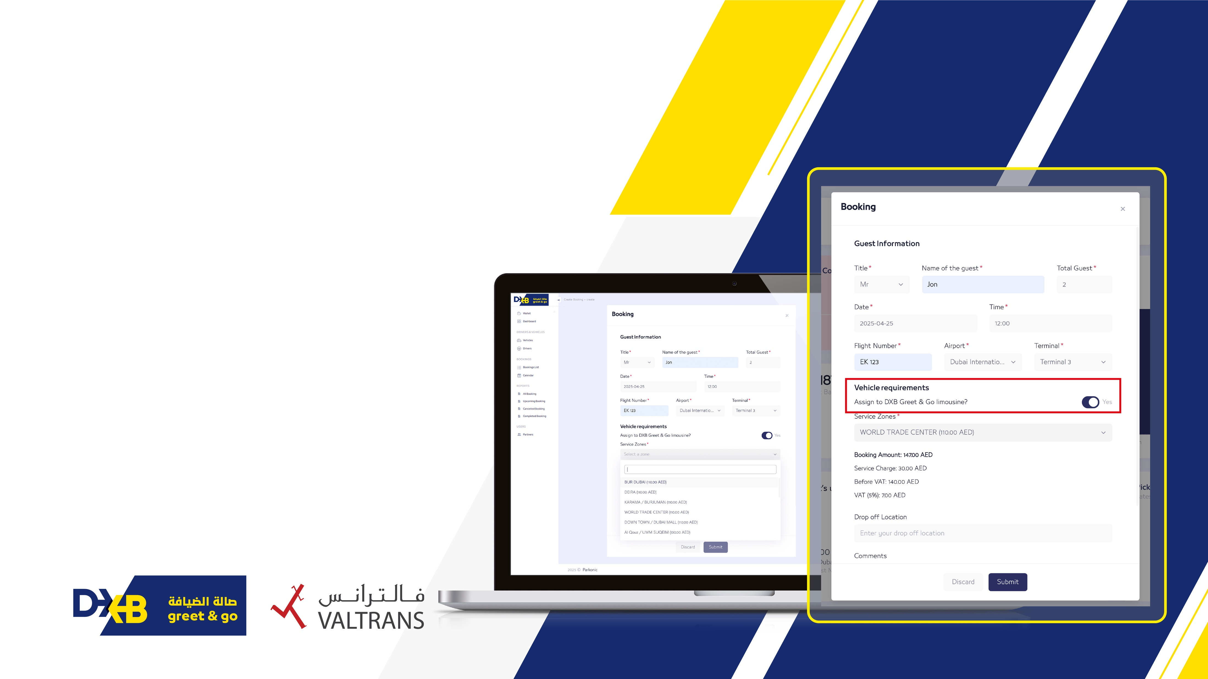


Booking methods
Create a booking and assign via DXB Greet & Go
Option:
03
Go to the Create a Booking section in the portal
Fill in the guest information, including:
Number of guests & flight details
Enable the Assign to DXB Greet & Go Limousine
option
Choose the required drop-off area and enter the exact location
Note: Additional location-based charges may apply

Slide 32
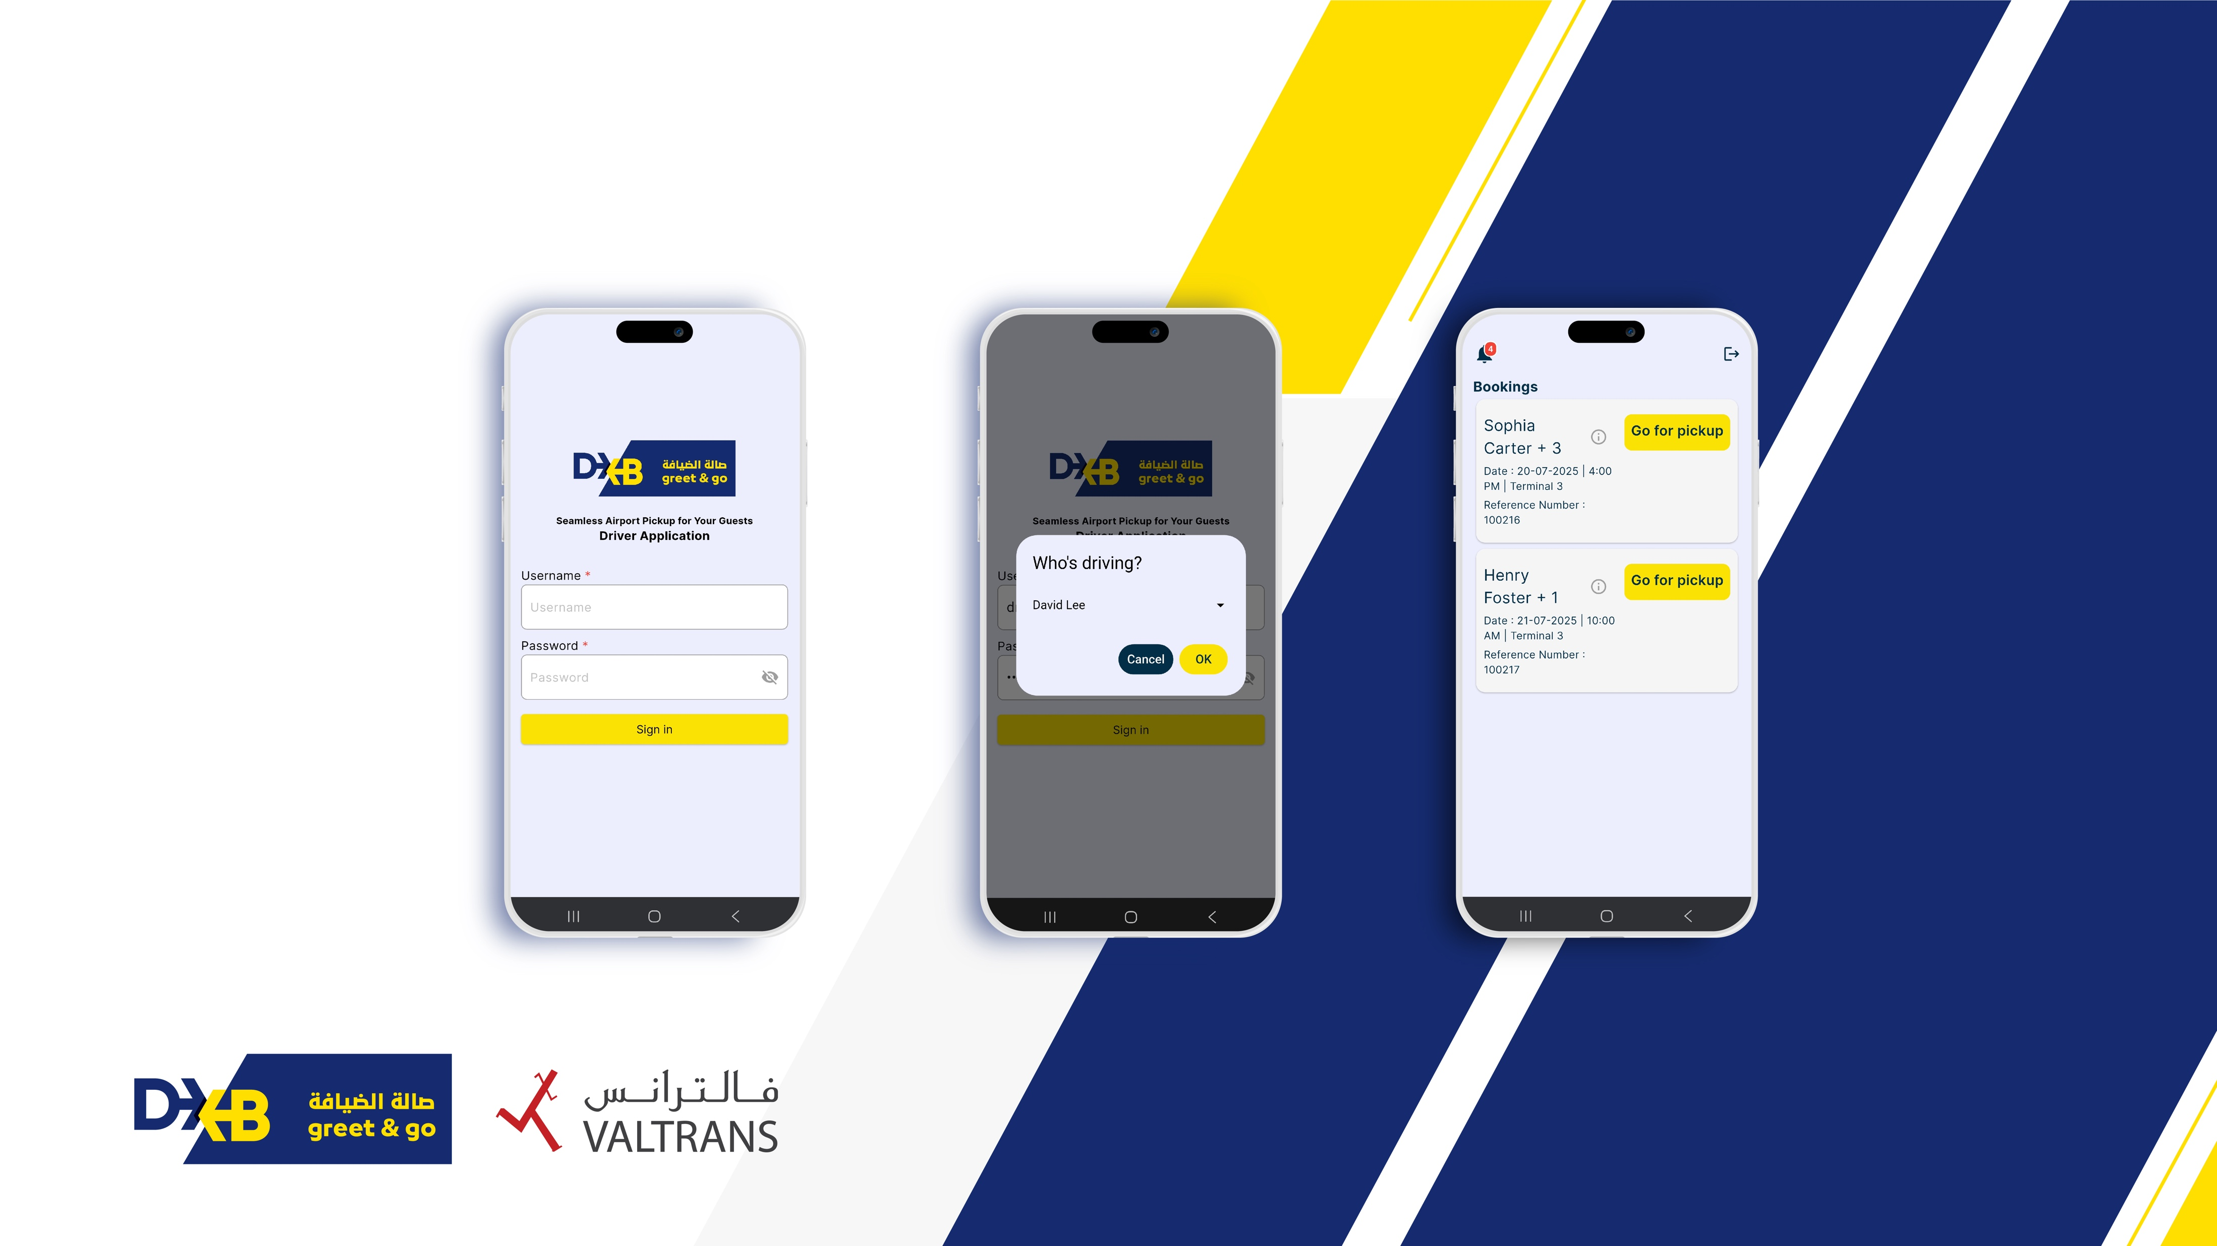
Overview of driver app

Slide 33
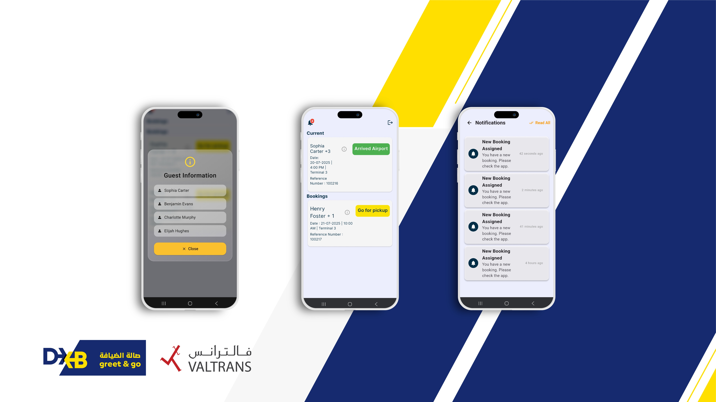
Overview of driver app

Slide 34
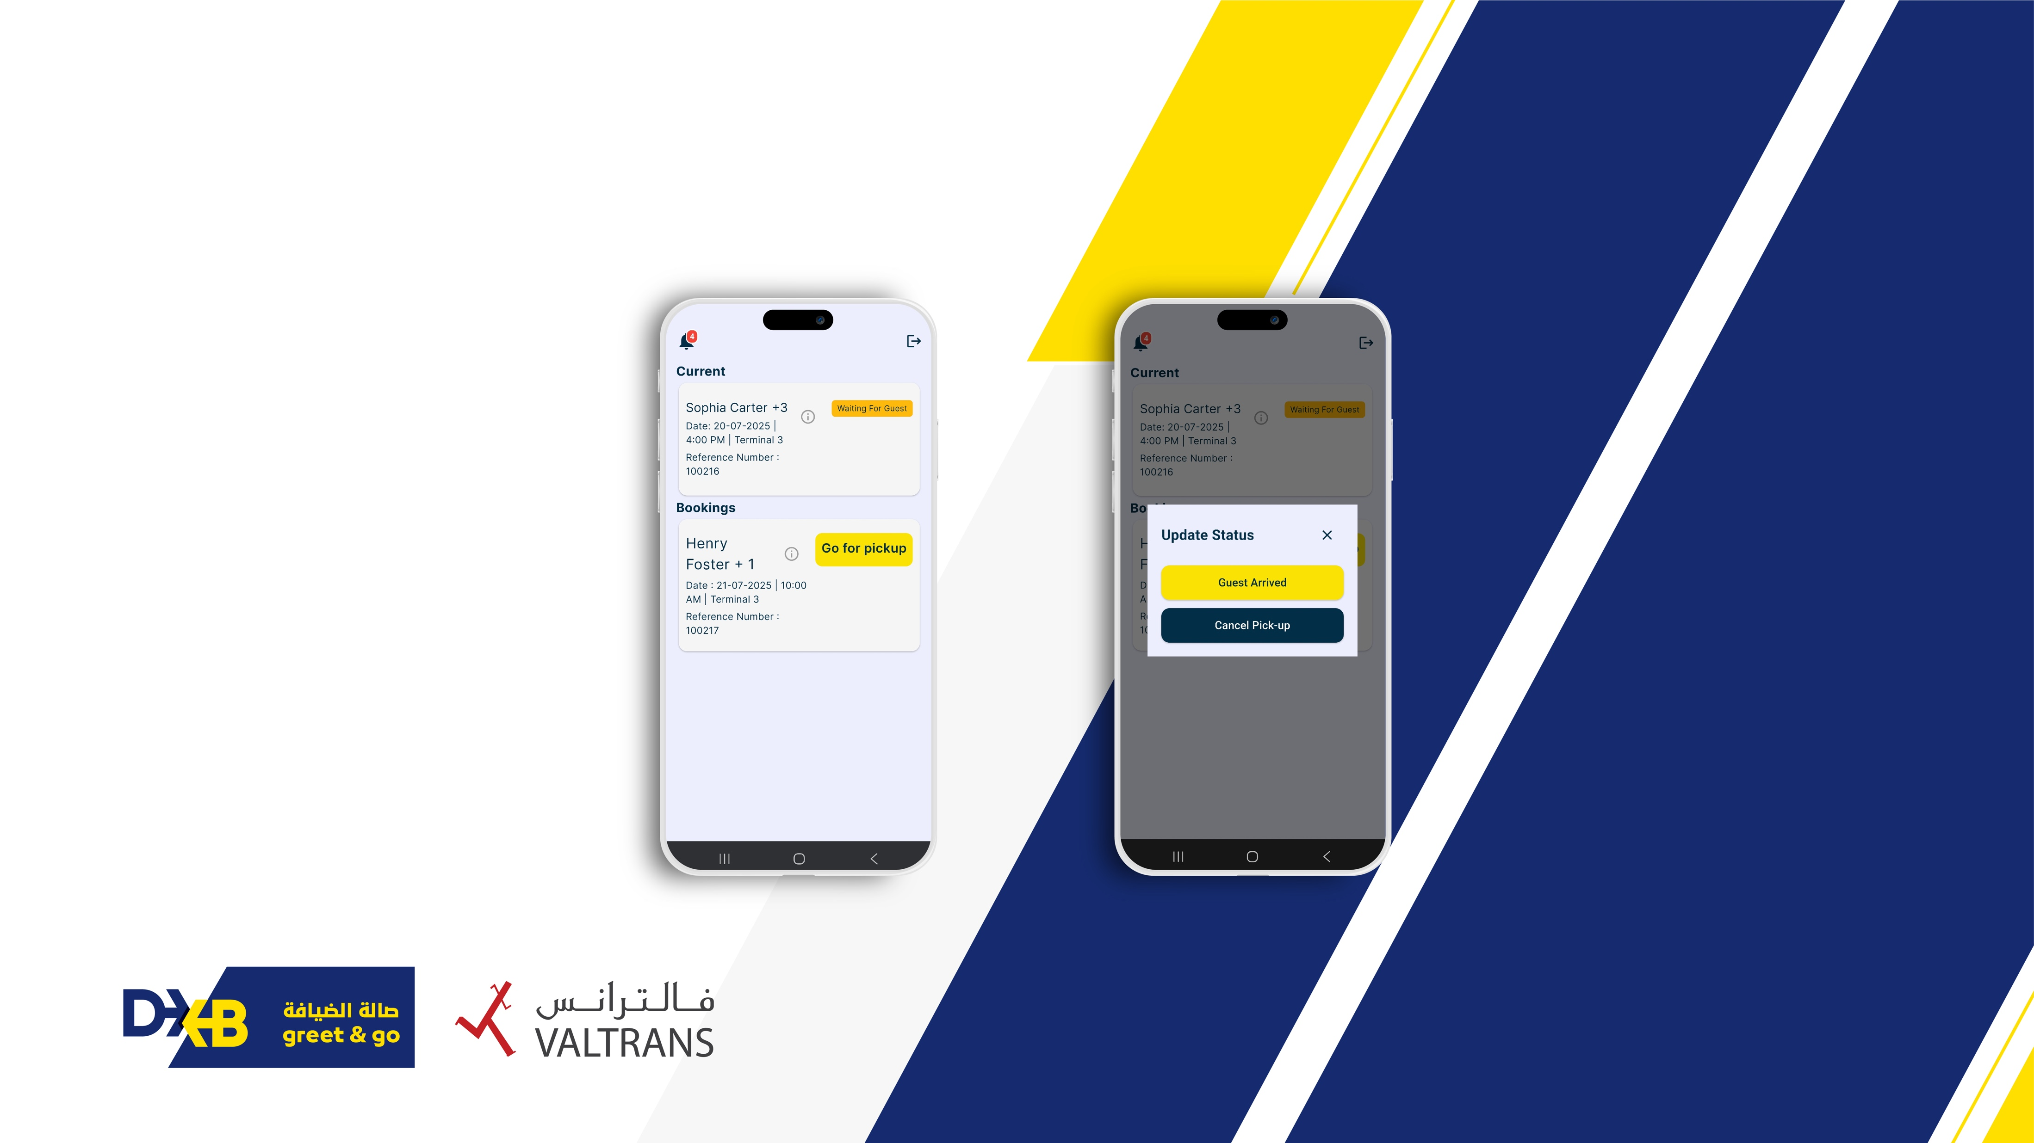
Overview of driver app

Slide 35
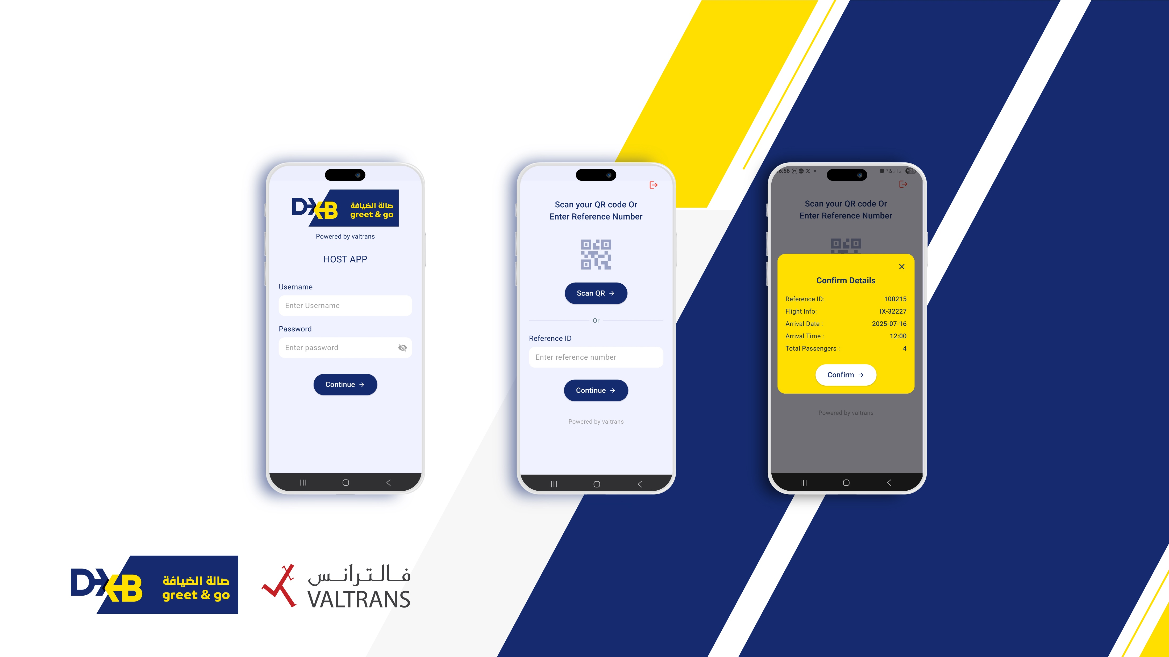
Overview of host app
Overview of host app

Slide 36
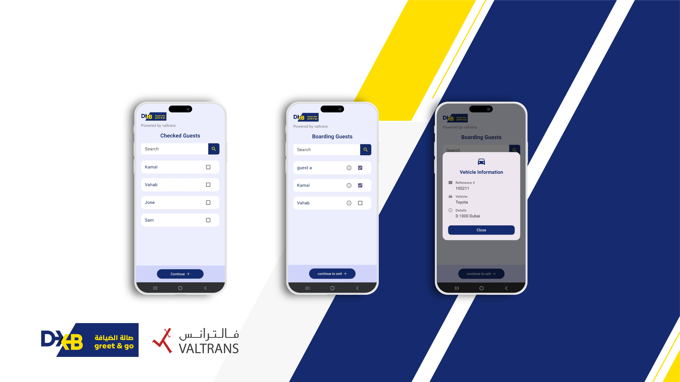
Overview of host app

Slide 37
Parking location at DXB T3
Ground Transport Operators (GTO) – T3 Departures
Near Emirates Group Check-in Area
Dedicated DXB Greet & Go Area – T3 Arrivals
All non-GTO registered vehicles entering Terminal 3 parking must obtain a valid ticket. Charges apply as per Dubai Airports policy.

Slide 38
Limo pricing structure - Pricing is applicable when Valtrans Limo is assigned incase the driver doesn’t show up
Location details from airport to other destinations - 4 seater
Sn. No | Zone A | Sub-zone | Price (AED)
1 | Deira | Deira City Centre Area | 220
2 | Deira | Al Rigga & Al Muraqqabat | 220
3 | Deira | Hor Al Anz & Abu Hail | 220
Remarks:
All above rates are exclusive of 5% VAT
All above tariffs include driver, fuel and Salik/DARB

Slide 39
Limo pricing structure
Location details from airport to other destinations - 4 seater
Sn. No | Zone B | Sub-zone | Price (AED)
1 | Central Dubai | Downtown Dubai | 260
2 | Central Dubai | Business Bay | 260
3 | Central Dubai | DIFC | 260
4 | Deira | Al Mamzar & Al Wuheida | 260
5 | Bur Dubai | Al Karama | 260
6 | Bur Dubai | Al Raffa & Mankhool | 260
7 | Bur Dubai | Oud Metha & Healthcare City | 260
8 | Bur Dubai | Al Jaddaf | 260
9 | North Dubai | Al Nahda (1 & 2) | 260
10 | North Dubai | Al Qusais (1,2,3 & Industrial) | 260
11 | North Dubai | Al Mamzar | 260
Remarks:
All above rates are exclusive of 5% VAT
All above tariffs include driver, fuel and Salik/DARB

Slide 40
Limo pricing structure
Location details from airport to other destinations - 4 seater
Sn. No | Zone C | Sub-zone | Price (AED)
1 | North Dubai | Mushrif Park Area | 280
2 | South Dubai | Al Barsha (1,2,3) | 280
3 | South Dubai | Dubai Sports City | 280
4 | East Dubai | Ras Al Khor (Industrial & Wildlife) | 280
5 | East Dubai | Nad Al Hammar | 280
6 | East Dubai | Al Warqa (1,2,3,4,5) | 280
7 | East Dubai | Al Khawaneej (1 & 2) | 280
8 | East Dubai | Al Mizhar (1 & 2) | 280
9 | West Dubai | Al Safa (1 & 2) | 280
10 | West Dubai | Al Manara | 280
11 | West Dubai | Jumeirah Beach Road | 280
12 | Other Location | JVC | 280
Remarks:
All above rates are exclusive of 5% VAT
All above tariffs include driver, fuel and Salik/DARB

Slide 41
Limo pricing structure
Location details from airport to other destinations - 4 seater
Sn. No | Zone D | Sub-zone | Price (AED)
1 | Central Dubai | Jumeirah (1,2,3, Umm Suqeim) | 300
2 | West Dubai | Umm Suqeim (1,2,3) & Al Qouz | 300
3 | West Dubai | Al Wasl | 300
Sn. No | Zone E | Sub-zone | Price (AED)
1 | South Dubai | Dubai Marina (Marina Walk & JBR) | 320
2 | South Dubai | Palm Jumeirah (Crescent, Trunk & Fronds) | 320
3 | South Dubai | Jumeirah Lake Towers (JLT - Clusters A-Z) | 320
4 | Other Location | Silicon Oasis | 320
5 | Other Location | Discovery Gardens | 320
Remarks:
All above rates are exclusive of 5% VAT
All above tariffs include driver, fuel and Salik/DARB

Slide 42
Limo pricing structure
Location details from airport to other destinations - 4 seater
Sn. No | Zone F | Sub-zone | Price (AED)
1 | Other Location | Jebel Ali | 380
2 | Other Location | Damac Hills | 380
3 | Other Location | Global Village | 380
Sn. No | Zone G | Sub-zone | Price (AED)
1 | Other Location | Abu Dhabi | 740
Remarks:
All above rates are exclusive of 5% VAT
All above tariffs include driver, fuel and Salik/DARB

Slide 43


Get in touch
contact@dxbgreetandgo.ae
800 82587267
Thank you

